Slide 1
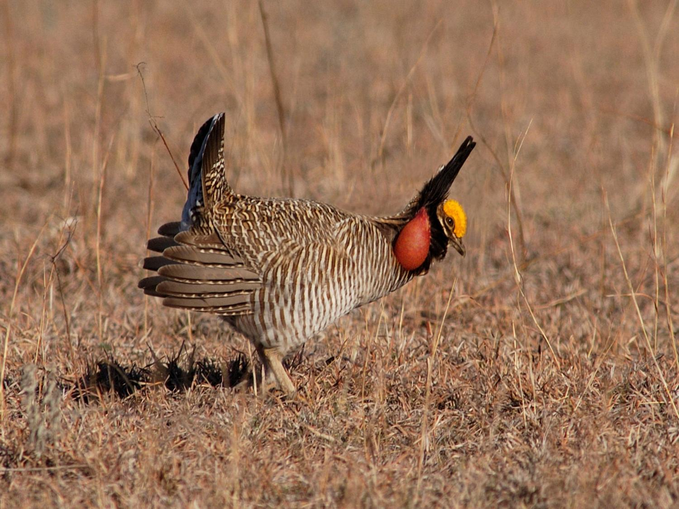







LEPC Conservation Plan & Mitigation Framework
Jim Pitman, Small Game Coordinator
KS Dept. of Wildlife, Parks, & Tourism

Slide 2
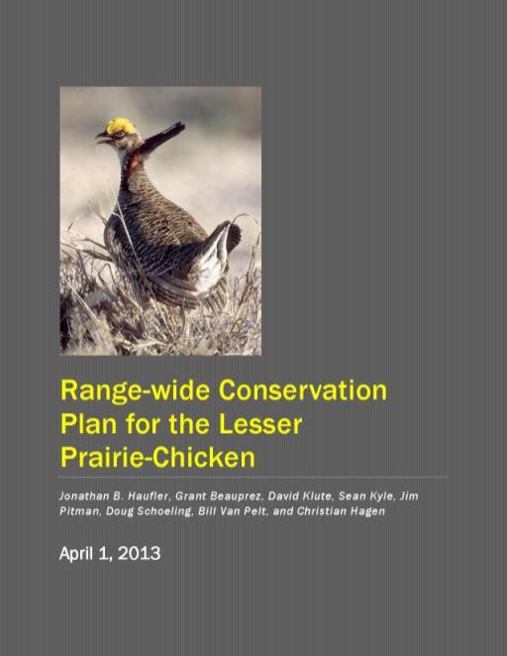
LEPC Conservation Plan
3rd Draft Released on April 1
Objective
  Long-term existence of LEPC & avert the need for a federal listing
Major Plan Components
  Population. & habitat goals
  Best locations for conservation efforts
  WAFWA Mitigation Framework
    Reduces threat identified by USFWS
Project Website: http://www.wafwa.org/html/rangewide_lpc_conservation_plan.shtml

Slide 3
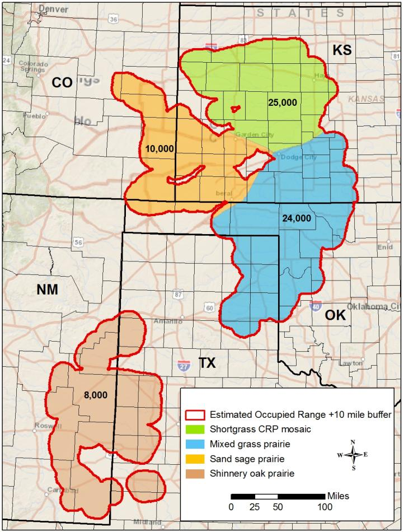
LEPC Population Goals
10-yr avg. of 67,000 birds
  2012 estimate of ~37,000
Planned pop. increases
  Sand sagebrush
  Shinnery Oak
  Mixed Grass
Planned pop. maintenance
  Shortgrass/CRP

Slide 4
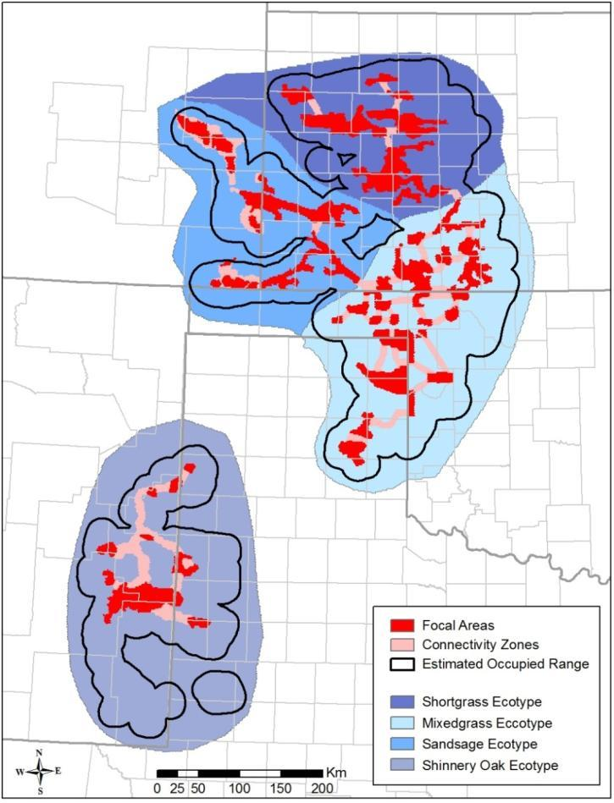
Focal Areas & Connectivity Zones
Ecoregion | Focal Area Acres | Connectivity Zone Acres
Sand Sagebrush | 1,583,360 | 245,120
Shortgrass/CRP | 1,872,640 | 183,680
Mixed Grass | 2,576,000 | 1,116,160
Shinnery Oak | 1,046,400 | 892,800
Total | 7,078,400 | 2,437,760

Slide 5
LEPC Crucial Habitat Assessment Tool (CHAT)
CHAT Category | Description
CHAT 1 | Focal Areas
CHAT 2 | Connectivity Zones
CHAT 3 | Known leks & predicted habitat
CHAT 4 | Remainder of range (+10 mi.)
http://kars.ku.edu/maps/sgpchat/

Slide 6
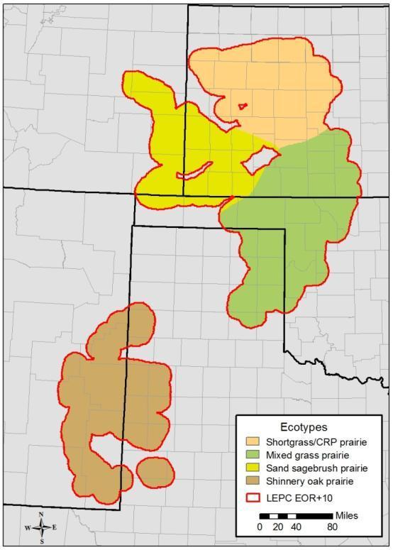
WAFWA Mitigation Framework
General Structure & Process
4 service areas in which impacted acreage will be offset with conservation actions
WAFWA habitat quantification tool
  works for all types of offset systems
WAFWA administers program
Success dependent upon voluntary participation from landowners and industry

Slide 7
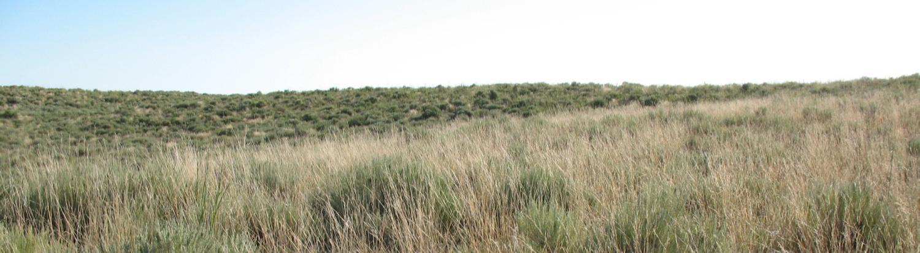
WAFWA Habitat Unit Estimation
General Process
Habitat Evaluation Guide (HEG)
  Utilizes 4 consistent variables to quantify habitat value
    Absolute Vegetation Cover
    Vegetation Composition (preferred grasses & shrubs)
    Presence of Tall Woody Plants (i.e. cedar infestation)
    Availability of suitable habitat within 1 mi. radius from center of unit
Only considers unimpacted acreage

Slide 8
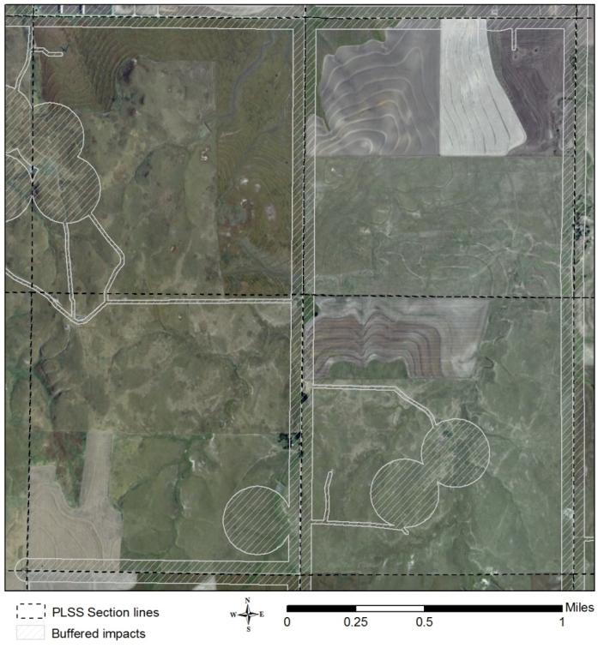
Impact Buffers
Feature | Impact Buffer (feet) | Max. Acres Impacted (rounded)
Oil & Gas Pads | 656 | 31
Turbines, Structures (>200 ft.), & Commercial Bldgs. | 2,188 | 345
Transmission Lines (≥69KV) (per mile) | 1,312 | 318
Distribution lines (<69KV) & Private Roads (per mile) | 33 | 8
Primary Roads (per mile) | 2,188 | 398
Secondary Roads (per mile) | 1,640 | 53
Residential Bldgs. | 133 | 14

Slide 9
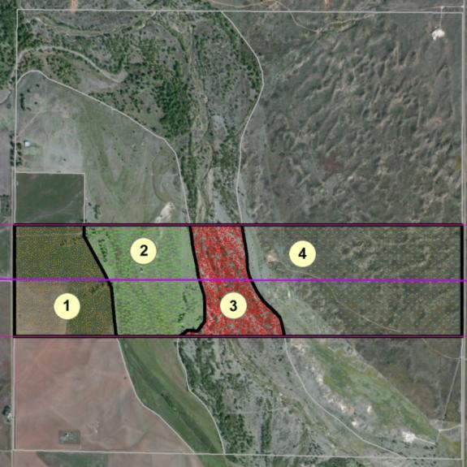
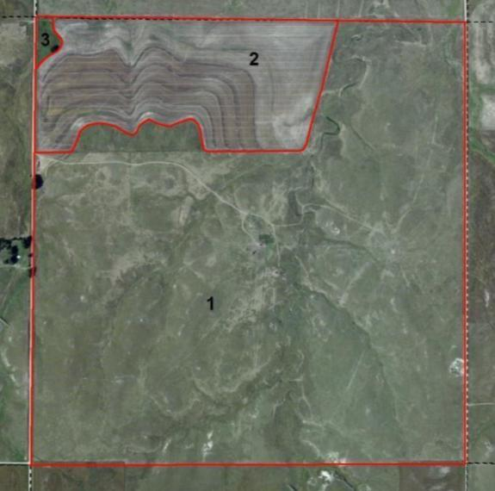
WAFWA Habitat Unit Estimation
Step 1: Delineating Evaluation Units
Similarly managed homogenous vegetation within area of interest
  further delineation of grassland if soil types differ within a management unit
New Transmission Line
Entire Ranch

Slide 10
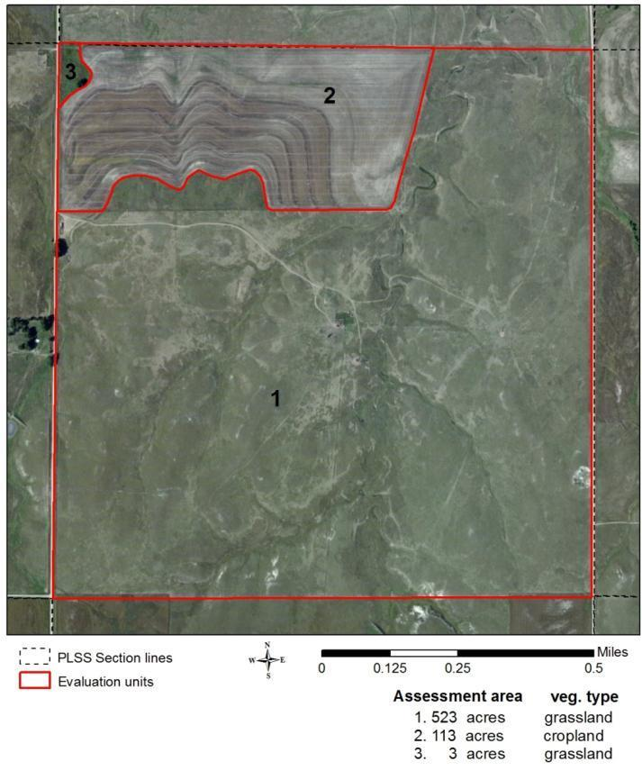
Habitat Unit Estimation
Step 2: On-site vegetation Monitoring
Standard (NRCS protocol)
  Two 150 ft. randomly placed and non-overlapping transects
  Number of transects can be adjusted based on unit size
Additional effort to estimate tree cover
Unit | Total Cover (Q1) | Veg. Comp. (Q2) | Tree Cover (Q3)
1 | 30% | 83% | 0.05%
2 | 10% | 0% | 0%
3 | 45% | 62% | 0.8%

Slide 11
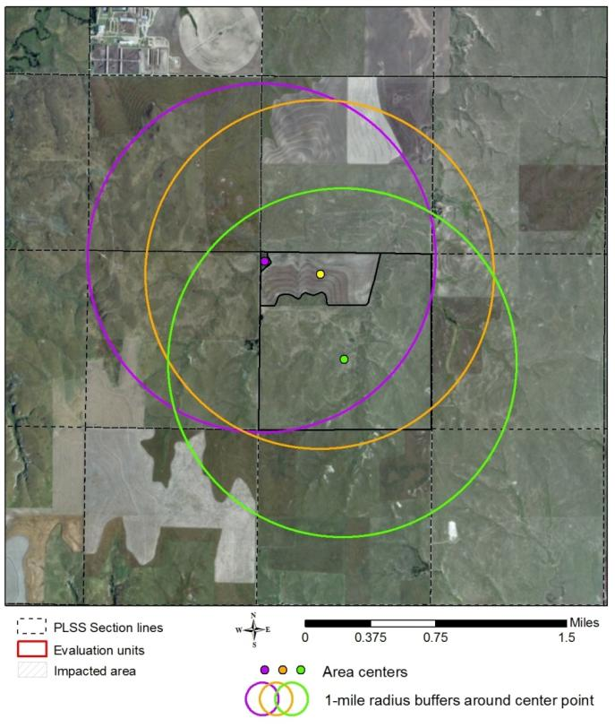
Habitat Unit Estimation
Step 3: Broad scale evaluations
Proportion of area within 1 mi. radius of geometric center of unit
  Defined as native prairie or planted native grasses with <1% tree cover
Unit | Total Cover (Q1) | Veg. Comp. (Q2) | Tree Cover (Q3) | Proportion Suitable (Q4)
1 | 30% | 83% | 0.05% | 0.85
2 | 10% | 0% | 0% | 0.80
3 | 45% | 62% | 0.8% | 0.80

Slide 12
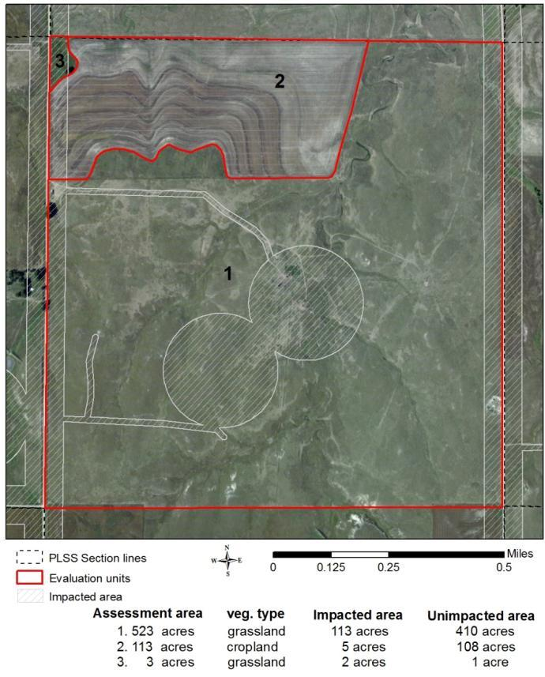
Habitat Unit Estimation
Step 4: Removing Previously Impacted Acreage
Only affected acreage that is currently unimpacted factors into unit estimation
Unit | Total Cover (Q1) | Veg. Comp. (Q2) | Tree Cover (Q3) | Proportion Suitable (Q4) | Acres
1 | 30% | 83% | 0.05% | 0.85 | 410
2 | 10% | 0% | 0% | 0.80 | 108
3 | 45% | 62% | 0.8% | 0.80 | 1

Slide 13
HEG Scoring Example
Unit 1 Calculation
Vegetation Cover
    >45% - 1.00
    30-45% - 0.85
    15-30% - 0.60
    <15% - 0.25
    Agricultural field - 0.05
Vegetation Composition (preferred species)
    >75% - 1.00
    50-75% - 0.85
    25-50% - 0.60
    <25% - 0.25
    Agricultural field - 0.05
Presence of Woody Plants (>3ft height)
    None - 1.00
    <1% - 0.85
    1-5% - 0.60
    >5% - 0.25
    Agricultural field - 0.05
Availability of Desired Cover (1 mi. radius)
    >90% - 1.00
    80-90% - 0.90
    - j) - 0.10 – 0.80
    None - 0.00
30%
85%
HEG Score: = Min Score (Q’s 1-3) X Q4 Score
  0.85 X 0.90 = 0.765
83%
Habitat Units = Unimpacted Acreage X HEG Score
  410 Acres X 0.765 = 313.65 units
0.05%
* 1 Unit = 1 acre of unimpacted high quality habitat as defined by the 4 HEG variables

Slide 14
Habitat Unit Estimation
Step 5: Tabulation of Total Units
Evaluation Unit | Unimpacted Acres |  | HEG Score |  | Units
1 (Pasture) | 410 | X | 0.765 | = | 313.65
2 (Ag field) | 108 | X | 0.04 | = | 4.32
3 (Grass corner) | 1 | X | 0.765 | = | 0.765
Total | 519 | NA | NA | NA | 318.74

Slide 15
Monetary Valuation of Habitat Units
Crucial Habitat Assessment Tool (CHAT)
CHAT Category | Approximate Unit Costs (range-wide avg.) | Cost-Share Basis (based on USDA rates)
CHAT 1 | $48.12 | 110-135%
CHAT 2 | $40.70 | 105%
CHAT 3 | $36.24 | 85-100%
CHAT 4 | $32.36 | 75-90%
CHAT 5 | $0 | 0%
http://Kars.Ku.edu/maps/sgpchat/

Slide 16
Annual Management Replacement Costs based on range-wide average costs
Evaluation Unit | Unimpacted Acres |  | HEG Score |  | Units
1 (Pasture) | 410 | X | 0.765 | = | 313.65
2 (Ag field) | 108 | X | 0.04 | = | 4.32
3 (Grass corner) | 1 | X | 0.765 | = | 0.765
Total | 519 | NA | NA | NA | 318.74
318.74 Units X $36.24 (CHAT 3) = $11,551.¹⁴

Slide 17
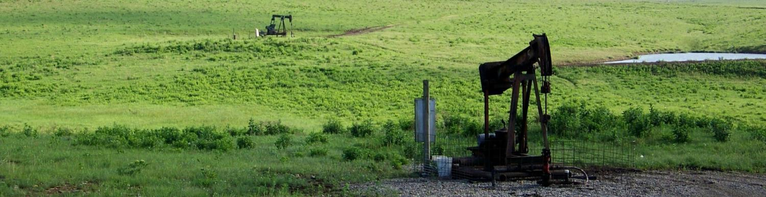
Estimating Impact Costs
Annual cost = Annual replacement + admin. fee (WAFWA = 15%)
Lifetime cost = annual cost x 20 years (duration)
  Offsets impacts in perpetuity with endowment & annual offset allocations
Adjusted lifetime cost = lifetime cost x 2
  2:1 ratio needed to reach population and habitat goals

Slide 18
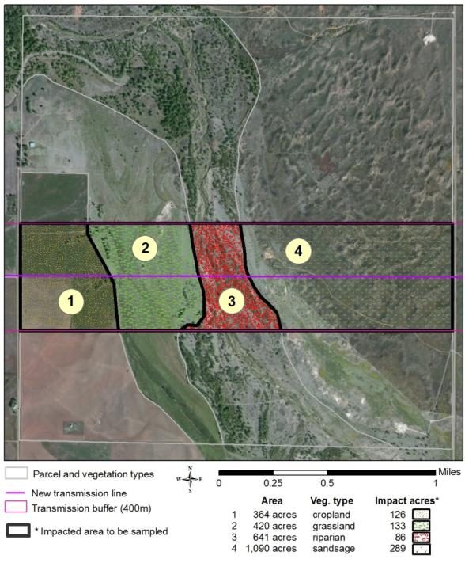
Development Cost Example range-wide avg. cost for CHAT 3 assumed
Unit | Newly Impacted Acres |  | HEG Score |  | Habitat Units
1 | 126 | X | 0.03 | = | 3.78
2 | 133 | X | 0.55 | = | 73.15
3 | 86 | X | 0.10 | = | 8.6
4 | 289 | X | 0.65 | = | 187.85
Total |  | NA | NA | NA | 273.38
Annual Replacement: 273 x $36.24 = $9,907
Administration Fee (15%) = $1,486
Total Annual Expense: $11,393
Lifetime Replacement : $12,475 x 20 = $227,862
Adjusted Lifetime Replacement Cost: $249,500 x 2 = $455,724

Slide 21
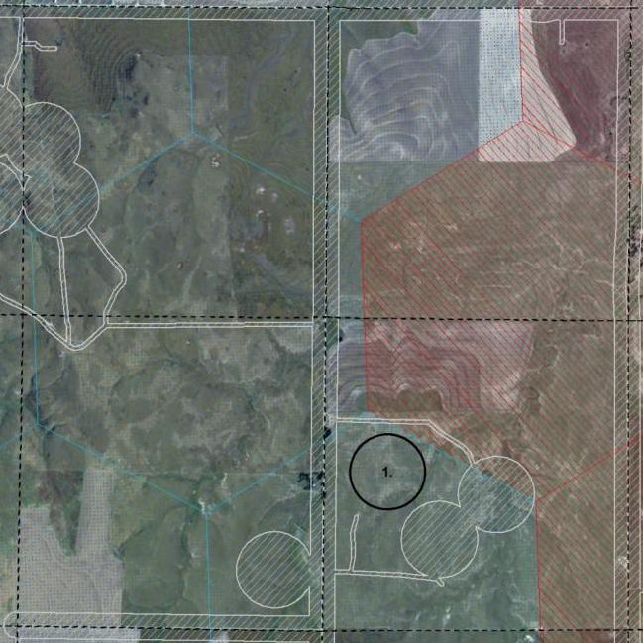
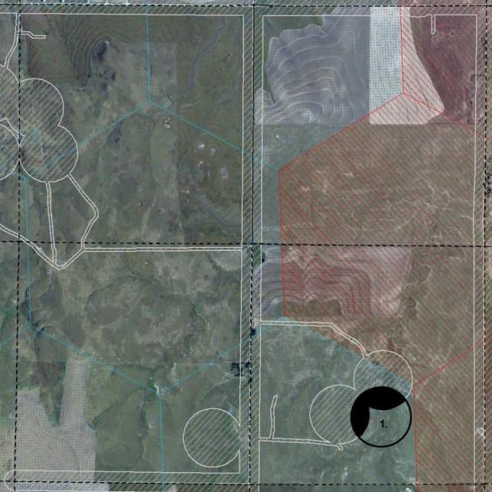
Clustering Developments another way to reduce costs
31 acres of new impact
vs.
17 acres of new impact

Slide 22
Offset Allocation contract options
Short Term (75%)
  Sign-up incentive
  5 year contract
  10 year contract
Long-Term (25%)
  Lump sum payment for perpetual conservation easement
    Annual payment for implementation of required mgmt. plan
    Available to properties in FA or CZ or by special authorization
    Preference for agreements with surface and mineral rights

Slide 23
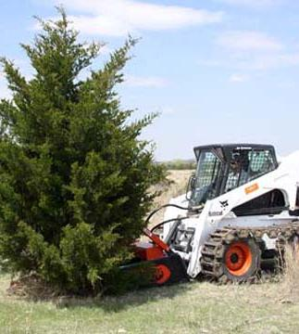
Offset Allocation
Practices & Conservation Plans
Restoration practices (10 yr contract)
  Brush management
  Range planting
Standard Mgmt. Plans (required)
  Rangeland conservation plan
    Prescribed grazing & burning, LEPC-friendly fencing, chemical treatment of invasive vegetation, etc.
  Planted grass conservation plan
    Requires mgmt activities at appropriate frequencies which can include burning, disking, interseeding, etc.

Slide 24
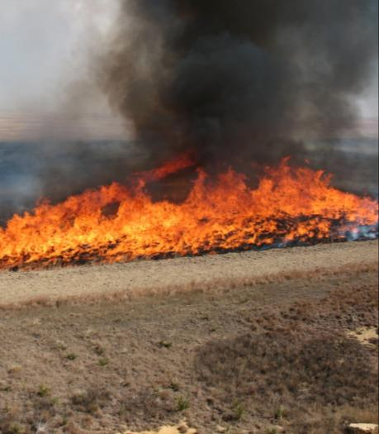
Offset Allocation
Practice Specifications
USDA specifications
  Rangeland prescribed fire, brush management, range planting, spot treatment of invasive plants, chemical treatment of mesquite, & fencing (NRCS)
  Planted grass management practices (FSA)
WAFWA specifications
  Prescribed grazing
    33% utilization
  Chemical treatment of shrubs
    Only for reduction of shinnery oak cover
Specifications are flexible

Slide 27
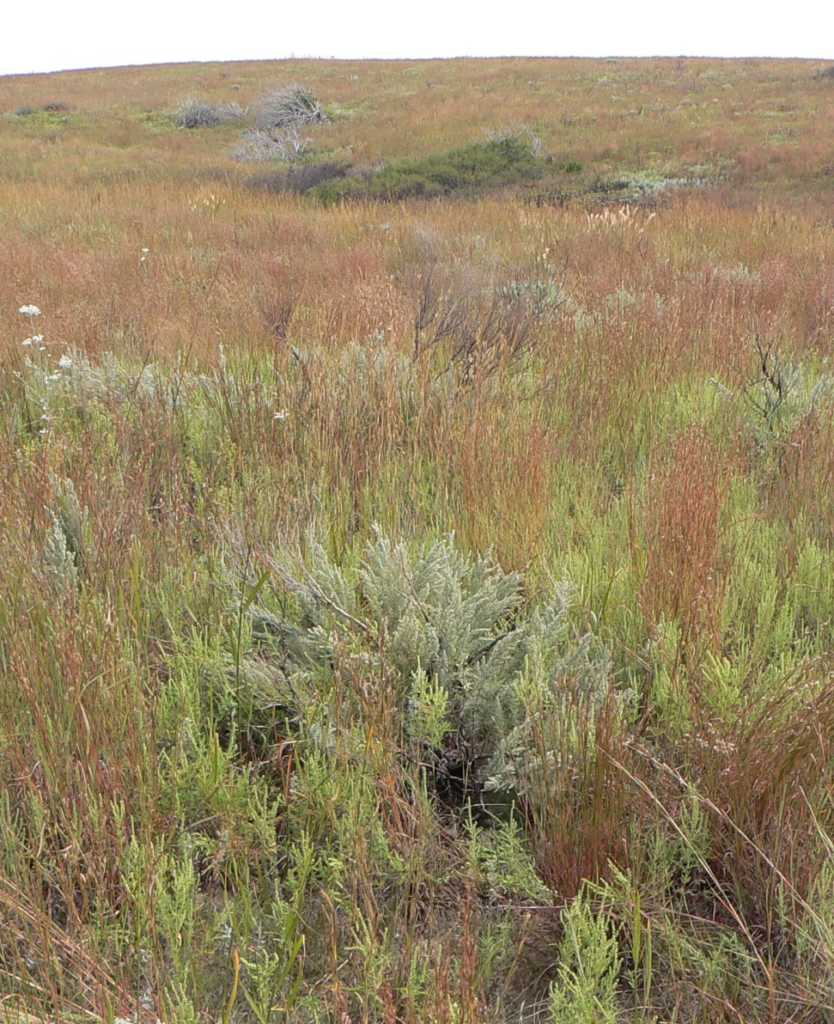
Long-Term Contracts available in CHAT 1 & 2
Max payment of 50% of appraised value for perpetual conservation easement
  Negotiable based on site potential, existing conditions, terms, etc.
Perpetual annual payments to cover implementation of required management plan

Slide 28
Offset Allocation proposed payment schedule
Short-term
  Following a signed contract for sign-up incentives
  Following a site verification for restoration practices
  Annually in the fall for standard plan implementation
Long-term
  Following a signed contract for conservation easement
  Annual management payment in the fall from endowment
Vegetation monitoring schedule established to track changes in quality and adjust annual payments

Slide 29
WAFWA Mitigation Framework
Administrative Structure
WAFWA Board of Directors (BOD)
5 State F&W Agency Directors
Advisory Board (AB)
Established by BOD
WAFWA LEPC Coordinator
Hired by BOD
Science Team
Already established
Fee Structure Working Group
Established by WAFWA
Technical Service Providers
Selected by BOD
Advisory Board
Contains WAFWA LEPC Coordinator and representation from conservation agencies, landowner groups, energy industry, biologists, municipalities, etc.
Meets at least annually and makes recommendations to BOD for technical service providers, dispute resolutions, cost structures, & adaptive management activities

Slide 30
Annual WAFWA Reporting
  Aerial survey report summarized for entire LEPC range and ecoregion (produced in mid-late summer)
      Breeding LEPC population estimates
  Affected Acreage Report summarized by focal area, connectivity zone, and ecoregion (produced in late fall)
      All managed acreage contracted by plan cooperators
      HEG scores from WAFWA contracted sites
      Land cover composition
      Impacted acreage
      WAFWA veg. data summarized by conservation practice (every 5th year)
Reports will be publicly available and provided to all plan cooperators

Slide 31
Adaptive Management Activities
Guided by progress towards population and habitat goals
Annual adaptations (as needed)
  Allocation of offsets to most needed locations & practices
  Ecoregion unit values (≤ 3% annual increase)
  Impact buffer distances for future enrollments
5-year adaptations (as needed)
  Reallocation of offset dollars to other ecoregions
  Shifting of priority areas
  Changes to WAFWA conservation practice specifications

Slide 32
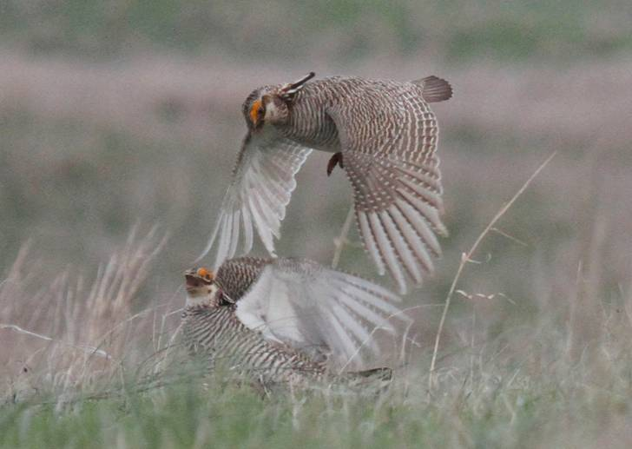

Timeline
WAFWA accepting comments on range-wide conservation plan through May 15
    Jan Caulfield
    114 S. Franklin St., Ste. 203
    Juneau, AK 99801
    janc@gci.net
USFWS accepting comments on proposed listing rule, proposed 4(d) special rule, and draft WAFWA conservation plan through June 20
WAFWA will begin enrollment in mitigation framework by mid-summer

