Slide 1
Lesser Prairie-Chicken Range-Wide Conservation Plan: Industry Mitigation Framework
WAFWA Lesser Prairie-Chicken Interstate Working Group

Slide 2
Goals of the Mitigation Framework
Preclude the need to list or provide a pathway to delist the species
Based on actual costs for habitat management and restoration
Develop a system that adequately addresses the unique challenges related to mitigation on private lands
Maximum flexibility possible for industry
Meet US Fish and Wildlife Service requirements for avoidance and minimization

Slide 3
WAFWA Mitigation Framework
WAFWA is the State Fish & Wildlife Agencies
Board of Directors—accountability
Not a public entity—confidentiality
501(c)(3 ) non-profit organization
Hire staff for conservation delivery
However, the mitigation framework is flexible for application by other conservation delivery organizations
Adjust administration costs appropriately

Slide 4
WAFWA Mitigation Framework Administrative Structure
WAFWA Board of Directors
5 State F&W Agency Directors
Advisory Board
Established by Board of Directors
Science Team
Fee Structure Working Group
Technical Service Providers
Advisory Board
Representation from energy industries, agriculture, landowner groups, and conservation organizations
Makes recommendations to Board of Directors related to operations for the mitigation framework
Receives guidance and data from science team, fee structure working group, and technical service providers

Slide 5
Enrollment for Mitigation
Who may enroll?
Any public or private entity that may impact LEPC habitat within the Estimated Occupied Range +10 miles (EOR+10)
How do I enroll?
Contact service provider and request enrollment
Provide spatial information detailing the extent of the acres to be enrolled
Sign an enrollment agreement with conservation measures
Pay the enrollment fees for the first 3 years
Provide information on impacts

Slide 6
Enrollment For Mitigation What are the enrollment fees for?
Enrollment fees are prepayment of future impacts
Once enrollment fees are debited for impacts, participants may add more funds to their account or pay mitigation fees as they develop a project

Slide 7
Conservation measures
Detailed in the plan:
Based on CHAT categories 1-3, known leks, and breeding season dates
See Range-Wide Plan for details on conservation measures—Please provide feedback

Slide 8
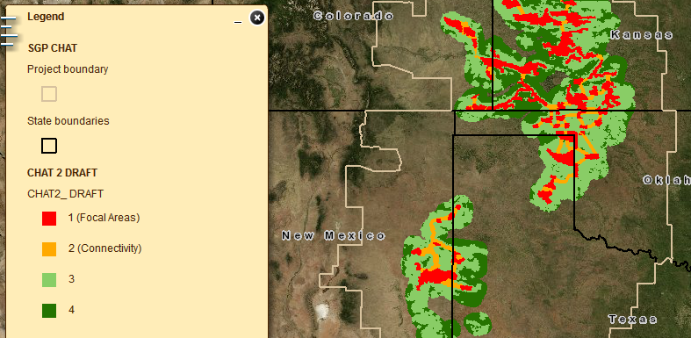
Draft CHAT 2.0 Online Now Spatial Representation of the LEPC-RWP
(Predicted High Quality Habitat)
(Other Potential Habitat)
http://kars.ku.edu/maps/sgpchat/

Slide 9
Mitigation What’s involved in the calculation of cost?
Acres Impacted
Impact Duration
Conservation Ratio
Habitat Quality
Habitat Management Cost
Administrative Cost

Slide 10
Mitigation What are the variables?
Acres Impacted
Impact Duration
Conservation Ratio
Habitat Quality
Habitat Management Cost
Administrative Cost
Fixed
Fixed
Fixed for WAFWA

Slide 11
Mitigation How are the costs calculated?
Mitigation Cost
Impact
Acres
Impact
Duration
Conservation
Ratio
Habitat Quality
Management & Admin Cost
=
x
x
x
x
Mitigation Cost
Impact
Acres
Habitat Quality
20-year Mitigation Management & Admin Cost
=
x
x
For the rest of the presentation:
Define variables and discuss how they function
Work through examples

Slide 12
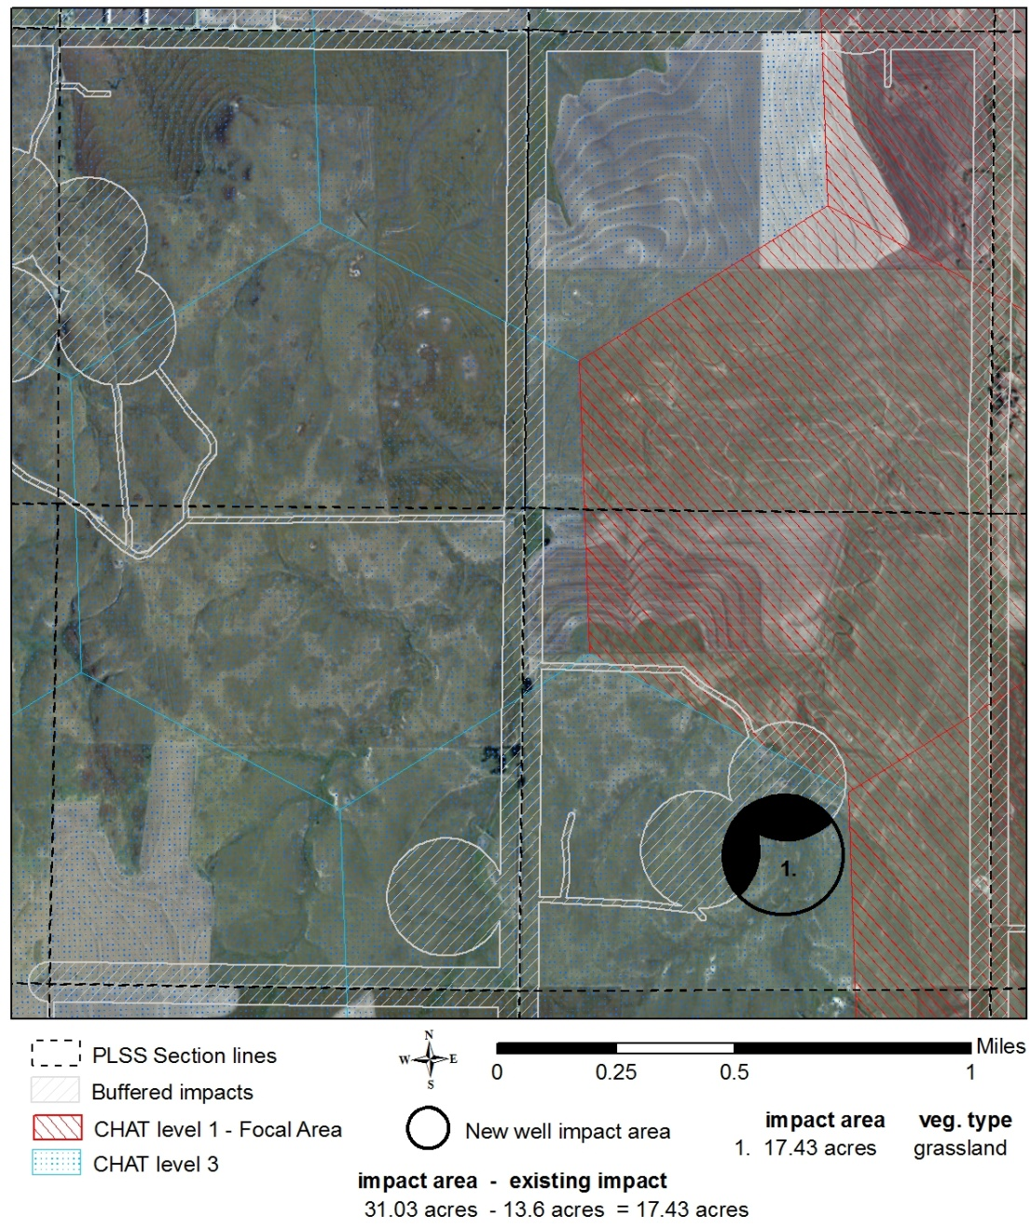
Impact Acreage
Impact Acreage = New impact acres – overlapping prior impact acres
Buffer overlap incentivizes clustering of development to directly reduce mitigation costs

Slide 13
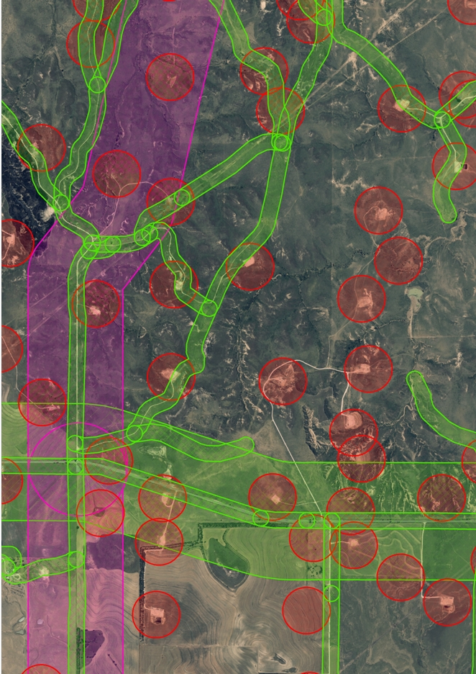
Impact Buffers
Represent habitat loss due to development
Simplified based on public feedback
Single distance based on best available science
We need your feedback to ensure that the buffer list is representative of development practices for all industries.

Slide 14
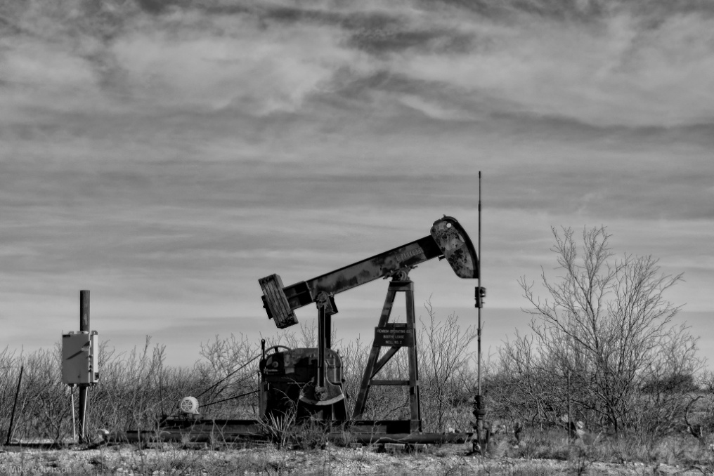
Impact Duration
All impacts are assessed for 20 years and considered permanent
Funds an endowment to pay for permanent offsets
Costs for remediated impacts may be credited to future impacts elsewhere

Slide 15
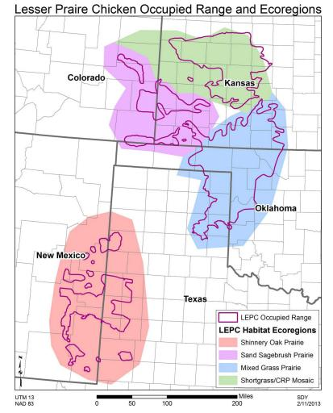
Conservation Ratio
Fixed 2:1 Impact
to Offset Ratio
25,000
Population goal is an average of 67,000 birds
2X the 2012 range-wide aerial survey population estimate
10,000
24,000
8,000

Slide 16
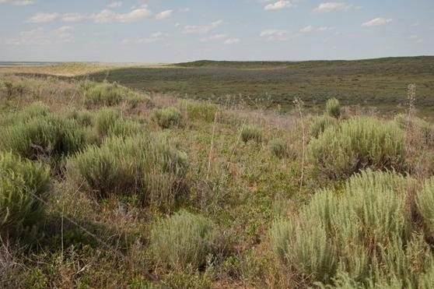
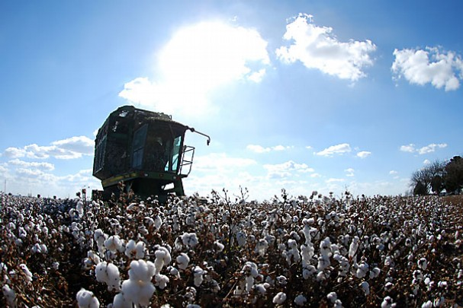
Habitat Evaluation Guide How does it work?
Rapid habitat evaluation based on 4 categorical variables
Vegetative cover
Vegetative composition (preferred grasses and shrubs)
Presence of tall woody vegetation (i.e. mesquite or cedar)
Availability of suitable habitat within 1 mile

Slide 17
Habitat Evaluation Guide Incentivizing Avoidance and Minimization
Higher quality habitat costs more, lower quality habitat and cropland costs less
Cropland with no rangeland in the vicinity scores a 0, which means no cost beyond enrollment

Slide 18
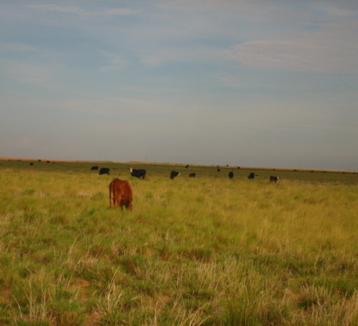
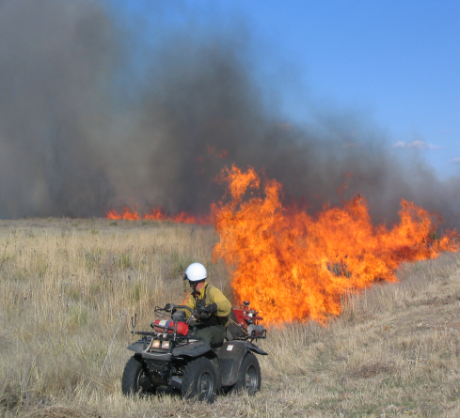
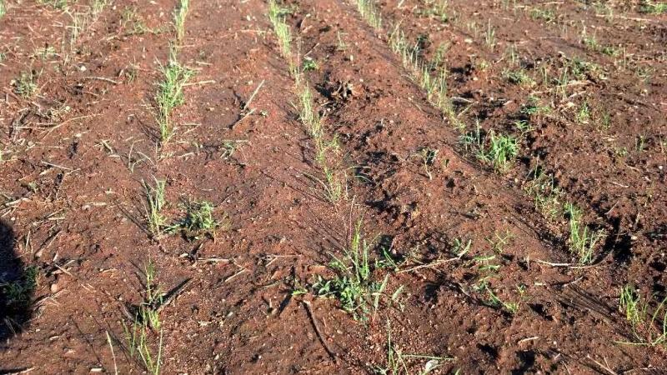
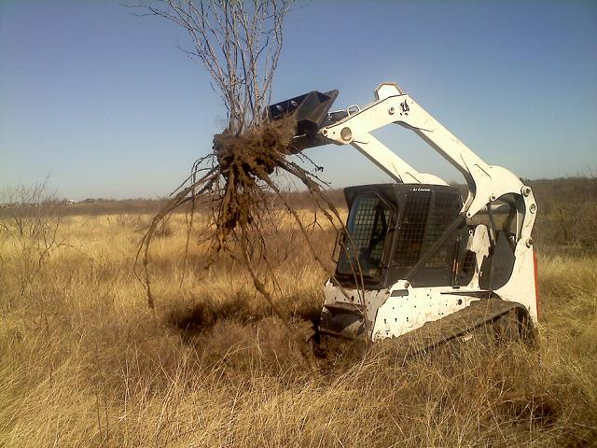
What is the management/admin cost?
Based on actual NRCS and FSA practice costs for restoration and maintenance of LEPC habitat
Restoration = native seeding and mechanical brush control
Maintenance = grazing, fire, CRP costs, and easement costs
Includes estimates of how much restoration and maintenance are required
WAFWA admin cost fixed at 15%
Individual cost estimates for each ecoregion

Slide 19
Ecoregional Habitat Management Costs
$34.69
$22.50
$56.63
Per acre/per year
$37.62

Slide 20
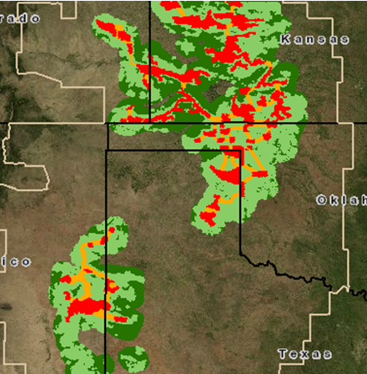
CHAT Weightings
Costs are weighted by CHAT category
Maintenance: 75%-135%
Restoration: 75%-110%
Why?
Managing for optimal habitat requires more than NRCS specs
Incentivize enrollment to meet habitat goals
Higher mitigation cost in CHAT1, lower in CHAT4

Slide 21
Management and Admin Cost Per Acre For high-quality, unimpacted rangeland
Sandsage Prairie Ecoregion --$22.50/acre
 | CHAT 1 | CHAT 2 | CHAT 3 | CHAT 4
Management Cost | $29.53 | $23.62 | $21.99 | $19.74
Administration Cost (15%) | $4.43 | $3.54 | $3.30 | $2.96
Total Annual Unit Cost | $33.96 | $27.16 | $25.29 | $22.70
Lifetime Unit Cost (20 years) | $679.13 | $543.28 | $505.78 | $454.04
Double Lifetime Unit Cost (2:1) | $1,358.26 | $1,086.55 | $1,011.57 | $908.09

Slide 22
Mitigations, Management, and Admin Cost Per Acre (MMA) For high quality, unimpacted rangeland
Ecoregion | CHAT 1 | CHAT 2 | CHAT 3 | CHAT 4
Mixed Grass | $3,203.76 | $2,763.17 | $2,422.26 | $2,159.10
Sand Sage | $1,358.26 | $1,086.55 | $1,011.57 | $908.09
Shinnery Oak | $2,095.68 | $1,844.59 | $1,591.19 | $1,415.52
Shortgrass | $2,006.81 | $1,646.53 | $1,502.03 | $1,345.22

Slide 23
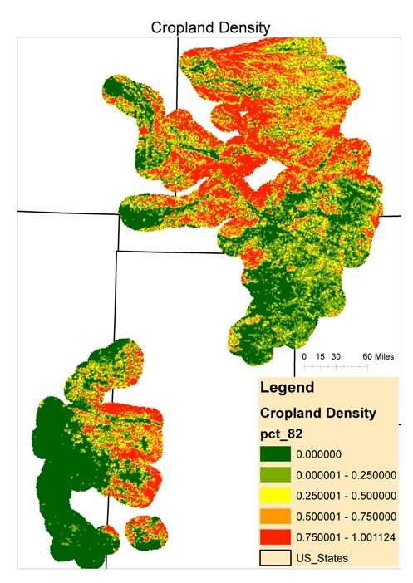
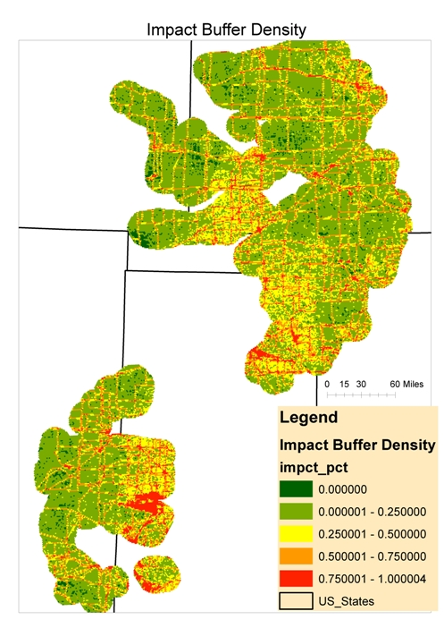
Where are mitigation costs lowest?

Slide 24
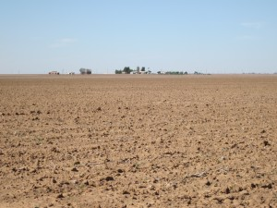
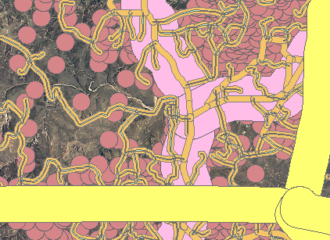
Where are mitigation costs lowest?
Cropland
Habitat Focal Areas—20.8%
Connectivity Zones—22.8%
CHAT 3-4—35%
Impact Buffers
Habitat Focal Areas—18.8%
Connectivity Zones—26.3%
CHAT 3-4—28.9%
More than 40% of the EOR +10
Spatial data provided to participants to minimize impacts and costs

Slide 25
Mitigation How are the costs calculated?
Mitigation Cost
Impact
Acres
Impact
Duration
Conservation
Ratio
Habitat Quality
Management & Admin Cost
=
x
x
x
x
Mitigation Cost
Impact
Acres
Habitat Quality
20-year Mitigation Management & Admin Cost
=
x
x
For the rest of the presentation:
Define variables and discuss how they function
Work through examples

Slide 26
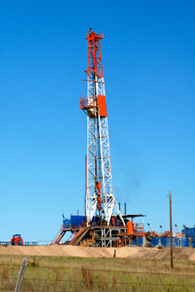
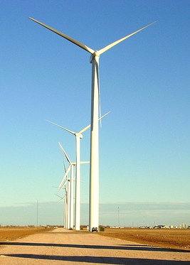
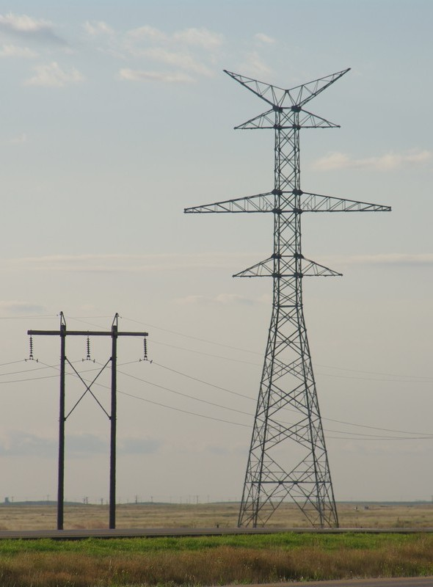
Mitigation Examples

Slide 27
Mitigation, Management, and Admin Cost Per Acre (MMA) For high quality, unimpacted rangeland
Ecoregion | CHAT 1 | CHAT 2 | CHAT 3 | CHAT 4
Mixed Grass | $3,203.76 | $2,763.17 | $2,422.26 | $2,159.10
Sand Sage | $1,358.26 | $1,086.55 | $1,011.57 | $908.09
Shinnery Oak | $2,095.68 | $1,844.59 | $1,591.19 | $1,415.52
Shortgrass | $2,006.81 | $1,646.53 | $1,502.03 | $1,345.22

Slide 28
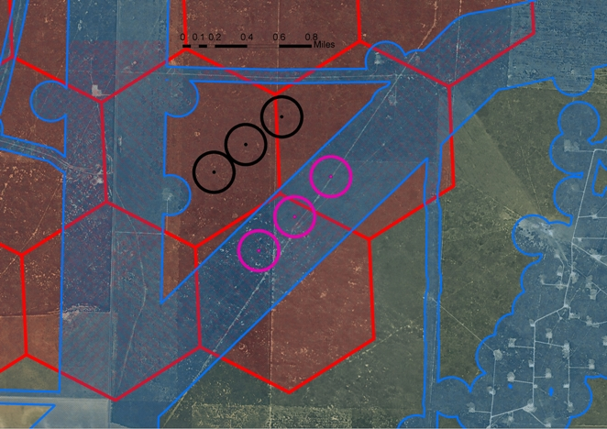
#1
#2
Oil and Gas Drilling Examples

Slide 29
Oil and Gas Example #1 Shinnery Oak Region, CHAT 1, no prior impacts
Impact Acreage
Habitat Quality
Mitigation Cost
3 wells @ 31.05 ac
No prior impacts
Impact Acres = 93.2
Veg Cover 30-45% = 0.85
>75% in preferred species = 1.0
No trees = 1.0
>90% desired veg w/in 1 mi = 1.0
Quality = 0.85 x 1
Quality = 0.85
MMA = $2,095.68/acre
Mitigation cost =
MMA x quality x impact acres
Mitigation cost = 2,095.68 x 0.85 x 93.2
$???

Slide 30
$149,418
#2
Oil and Gas Drilling Examples

Slide 31
Oil and Gas Example #2 Shinnery Oak Region, CHAT 1, within prior impacts
Impact Acreage
Habitat Quality
Mitigation Cost
3 wells @ 31.05 ac
Sited in existing transmission buffer
Impact Acres = 0
Veg Cover 30-45% = 0.85
>75% in preferred species = 1.0
No trees = 1.0
>90% desired veg w/in 1 mi = 1.0
Quality = 0.85 x 1
Quality = 0.85
MMA = $2,095.68/acre
Mitigation cost =
MMA x quality x impact acres
Mitigation cost =
2,095.68 x 0.85 x 0
$???

Slide 32
$149,418
$0
After Enrollment
Oil and Gas Drilling Examples

Slide 33
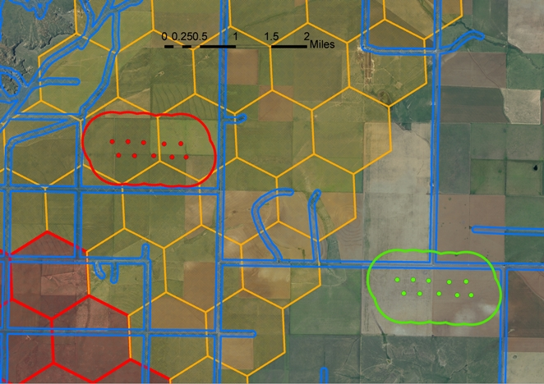
#1
#2
Wind Energy Development Examples

Slide 34
Wind Energy Example #1 Shinnery Oak Region, CHAT 2, no prior impacts
Impact Acreage
Habitat Quality
Mitigation Cost
10 turbines
No prior impacts
Impact Acres = 1,068.7
Veg Cover > 45% = 1.0
50-75% preferred spp = 0.85
No woody plants >3’ = 1.0
80-90% desired veg within 1 mile = 0.9
Quality = 0.85 x 0.9
Quality = 0.765
MMA = $1,844.59/acre
Mitigation cost =
MMA x quality x impact acres
Mitigation cost = 1,844.59 x 0.765 x 1068.7
$???

Slide 35
$1,508,055
#2
Wind Energy Development Examples

Slide 36
Wind Energy Example #2 Shinnery Oak Region, CHAT 3, in cropland
Impact Acreage
Habitat Quality
Mitigation Cost
10 turbines
Overlaps an existing secondary road
Impact Acres = 972.8
Tilled = 0.05
Tilled = 0.05
Tilled = 0.05
10-20% desired veg within 1 mile = 0.2
Quality = 0.05 x 0.2
Quality = 0.01
MMA = $1,591.19/acre
Mitigation cost =
MMA x quality x impact acres
Mitigation cost =
1,591.19 x 0.01 x 972.8
$???

Slide 37
$1,508,055
$14,779
Wind Energy Development Examples

Slide 38
Transmission Examples
Per mile of >69 kV in:
CHAT 2, no prior impacts
CHAT 3, cropland
CHAT 1, within existing primary road impact buffer

Slide 39
#2--1 mile of line in CHAT 3, cropland = $5,868
#1—1 mile of line in CHAT 2, CRP = $448,875
Transmission Line Examples

Slide 40
1 mile of line sited along existing state highway = $0 after enrollment
Oil and Gas Drilling Examples

Slide 41
Mitigation Take-Home
Mitigation cost is directly affected by the amount of area impacted, the habitat quality, the CHAT category, and the presence of prior impacts.
At least 40% of the area covered under the Range-Wide Plan is cropland or has pre-existing impact buffers that offer opportunities to develop with significantly reduced mitigation costs
The States can provide this spatial information to participants to minimize both their impacts and their costs.

Slide 42
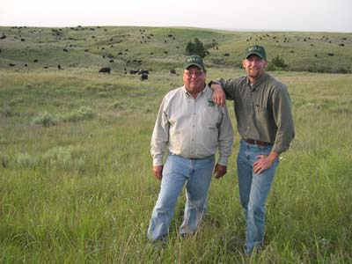
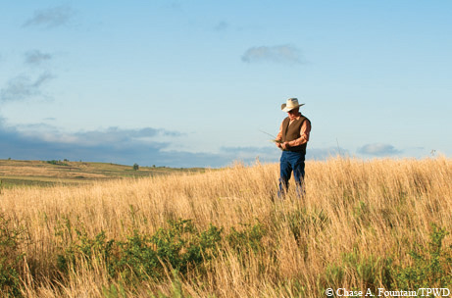
Where does the money go?
To farmers, ranchers, and landowners for the management of LEPC habitat
Modest incentive payments for enrollment
Habitat restoration costs as completed
Annual habitat maintenance payments based on performance
Funding is targeted to meet the goals in the Range-Wide Plan
Private mitigation funds may be used as match for grant funds for additional conservation and research

Slide 43
This mitigation framework is designed to preclude the need to list the LEPC or provide a pathway to delisting, but accomplishing those goals requires enrollment from industry.
This framework will also ensure that the management of the LEPC remains in the hands of the States.

Slide 44
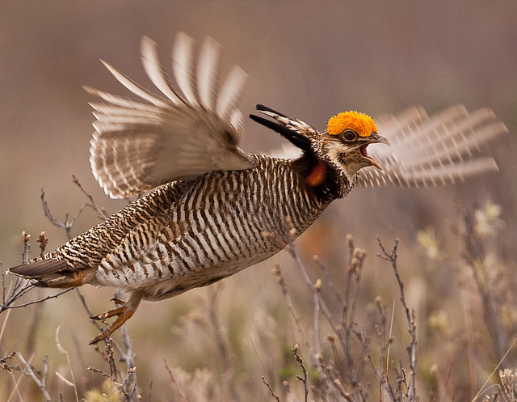
Find the LEPC Range-wide Conservation Plan at
http://www.wafwa.org/html/prairie_chicken.shtml
Please submit questions or comments on the LEPC Range-wide Conservation Plan to janc@gci.net by May 15 or to your Interstate Working Group member in each state.

Slide 45
LEPC Interstate Working Group
CO: David Klute – David.Klute@state.co.us
KS: Jim Pitman – Jim.Pitman@ksoutdoors.com
OK: Doug Schoeling – schoelingd@pldi.net
NM: Grant Beauprez – Grant.Beauprez@state.nm.us
TX: Sean Kyle – Sean.Kyle@tpwd.state.tx.us

