Slide 2
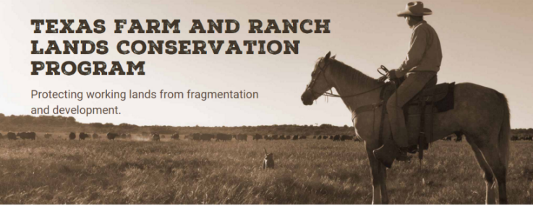

Slide 3
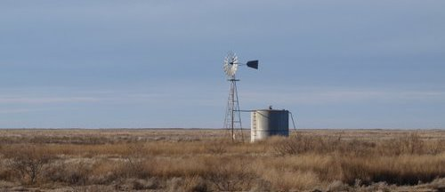
Review of Training Program
Provided to the Council by TPWD Staff
Texas Farm and Ranch Lands Conservation Council
January 28, 2016

Slide 4
Overview
HB 1925, which moved the Texas Farm and Ranch Lands Conservation Program (TFRLCP) from the Texas General Land Office (GLO) to Texas Parks and Wildlife Department (Department), requires that Texas Farm and Ranch Lands Conservation Council (Council) members are provided with certain information and training.
Council members were sent an information and training binder. This presentation will highlight some of that information.

Slide 5
Changes Made to the Texas Farm and Ranch Lands Conservation Program by HB 1925
Program to be managed by TPWD rather than GLO
Number of Council members increased from 10 to 12
More emphasis is placed on protecting agricultural lands susceptible to development

Slide 6
Program Goals and Objectives
The goal of the TFRLCP is conservation of working lands with high values for water, fish and wildlife, and agricultural production, especially lands at risk of development. The program supports TPWD’s mission to encourage stewardship of private working lands for conservation of natural resources.

Slide 7
TFRLCP Administration
TFRLCP is managed within the Land Conservation Program of the Executive Office of the Texas Parks and Wildlife Department by:
Ted Hollingsworth, Land Conservation Program Director with assistance from:
Carla Beavers, Land Conservation Program Staff Services Officer
Jeannie Munoz, Project Management Office Director
Robert Sweeney, TPWD Staff Attorney

Slide 8
Project Management
The TFRLCP Application Form and Draft Selection Criteria were prepared by a team of TPWD biologists. The same team with use the Selection Criteria adopted by the Council to rank project applications. The team consists of:
Justin Dreibelbis, Wildlife Division
Jeff Raasch, Wildlife Division
Tim Birdsong, Inland Fisheries Division
Ted Hollingsworth, Land Conservation Program

Slide 9
Project Budget
The TFRLCP was transferred to TPWD with an appropriation of $2,000,000 for administration of the program, of which $1,760,910 was specifically appropriated for grants and transaction costs related to purchase of agricultural conservation easements. Staff recommends setting aside a nominal amount of the appropriation for program management costs, and making the rest available for grants and transaction costs.
Appropriation for FY 2016 $ 1,887,665
Appropriation for FY 2017 112,335
Total Appropriation for biennium $ 2,000,000

Slide 10
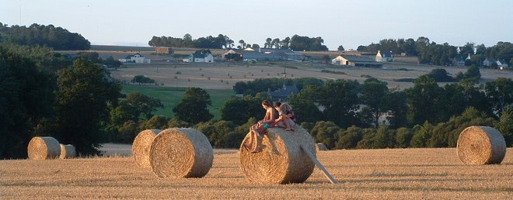
Questions ?

