Slide 3
Natural Resources Conservation Service Grant Programs
And Other Potential Sources for Matching Funds
Texas Farm & Ranch Lands
Conservation Program
Council Meeting
January 28, 2016

Slide 4
TFRLCP Funding
84th Legislature appropriated $2 MM for FY16-17 biennium
$1.88 MM available in FY16
$112 K available in FY17
Small amount will earmarked for operating expenses; the rest allocated to grants
Funds must be encumbered by August 31, 2016

Slide 5
Leveraging TFRLCP Funds
Leveraging available state funds with other sources is a major objective for the TFRLCP
TPWD staff working with NRCS staff to coordinate leveraging opportunities with Farm Bill conservation easement program
Goals and selection criteria line up well with those of the TFRLCP
NRCS applications were due January 15, 2016
Several applications were submitted that identified TFRLCP funds as potential source of match

Slide 6
Taking Advantage of NRCS Programs
2016 March: TFRLCP Council meeting to review TPWD grant award recommendations
2016 March: NRCS notified of projects selected by the Council for match funding
2016 June: NRCS will finalize their process and make grant offers
2016 September: NRCS Grant Agreements are to be executed by 09-16-16
Work on projects (conservation easement transactions) can begin at that point
NRCS provides funds at closing

Slide 7
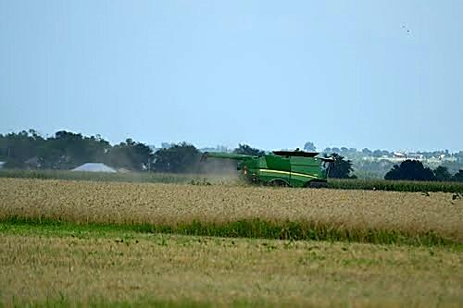
Other Opportunities
Selection criteria consider cost effectiveness and leveraging
Donations and bargain sales are encouraged
Other sources of match funding are encouraged

Slide 8
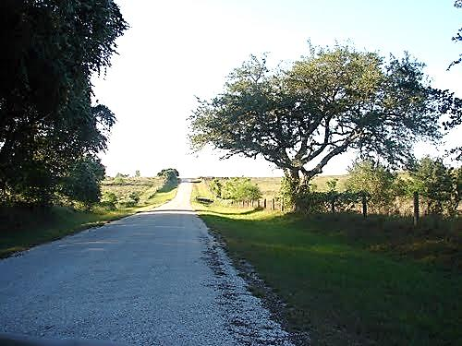
Questions?

