Slide 3
Consideration by Council
Adoption of the Scoring Process for Evaluating and Awarding TFRLCP Grants
Texas Farm & Ranch Lands
Conservation Program
Council Meeting
January 28, 2016

Slide 4
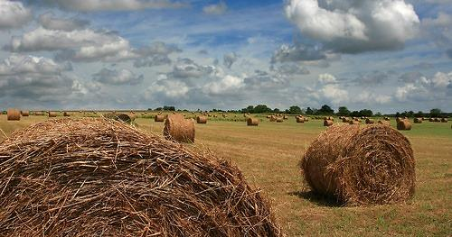
HB 1925, Section 84.010
The Council shall - give priority to applications that protect highly productive agricultural lands that are susceptible to development, including subdivision and fragmentation; and

Slide 5
HB 1925, Section 84.010
The Council shall - Adopt a scoring process to be used in evaluating applications that considers the following:
maintenance of landscape and watershed integrity to conserve water and natural resources
protection of habitats for native plant and animal species, including habitats for endangered, threatened, rare, or sensitive species
potential for leveraging state money allocated to the program with additional public or private money
proximity of the subject property to other protected lands
the term of the proposed easement, whether perpetual or for a term of 30 years
a resource management plan agreed to by both parties and approved by the Council

Slide 6
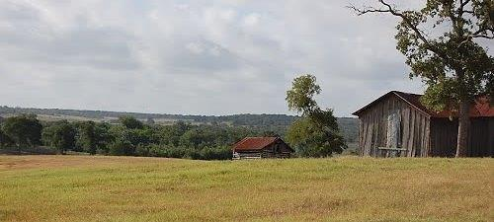
Selection Criteria Development
TPWD assembled a Project Review Committee for the purpose of
Developing selection criteria
Ranking project applications
Making project recommendations to the Council

Slide 7
Project Review Committee
Tim Birdsong, Ecosystem/Habitat Assessment Chief, Inland Fisheries Division
Justin Dreibelbis, Private Lands and Public Hunting Program Director, Wildlife Division
Corky Kuhlmann, Land Conservation Program Senior Project Manager, Executive Office
Jeff Raasch, Statewide Wetland Habitat Program Leader, Wildlife Division
Ted Hollingsworth, Land Conservation Program Director, Executive Office

Slide 8
Proposed Selection Criteria
Total possible score 100
Threat of development or other conversion to productive working lands (20)
Value (20)
Watershed value (20)
Fish and wildlife value (20)
Contribution to a conservation landscape (10)
Terms of the conservation easement (10)

Slide 9
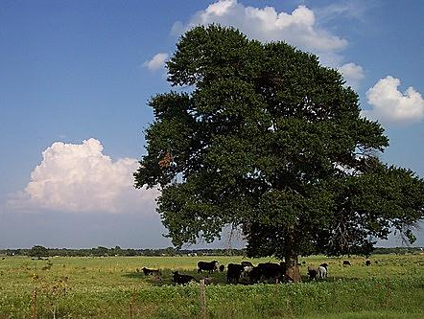
Questions or Comments?

Slide 10
The staff recommends the Texas Farm and Ranch Lands Conservation Council adopt the following motion:
“The Texas Farm and Ranch Lands Conservation Council adopts the Scoring Criteria attached as Exhibit A and authorizes their use for all purposes related to the ranking of applications for the
2016 grant cycle.”

