Slide 1
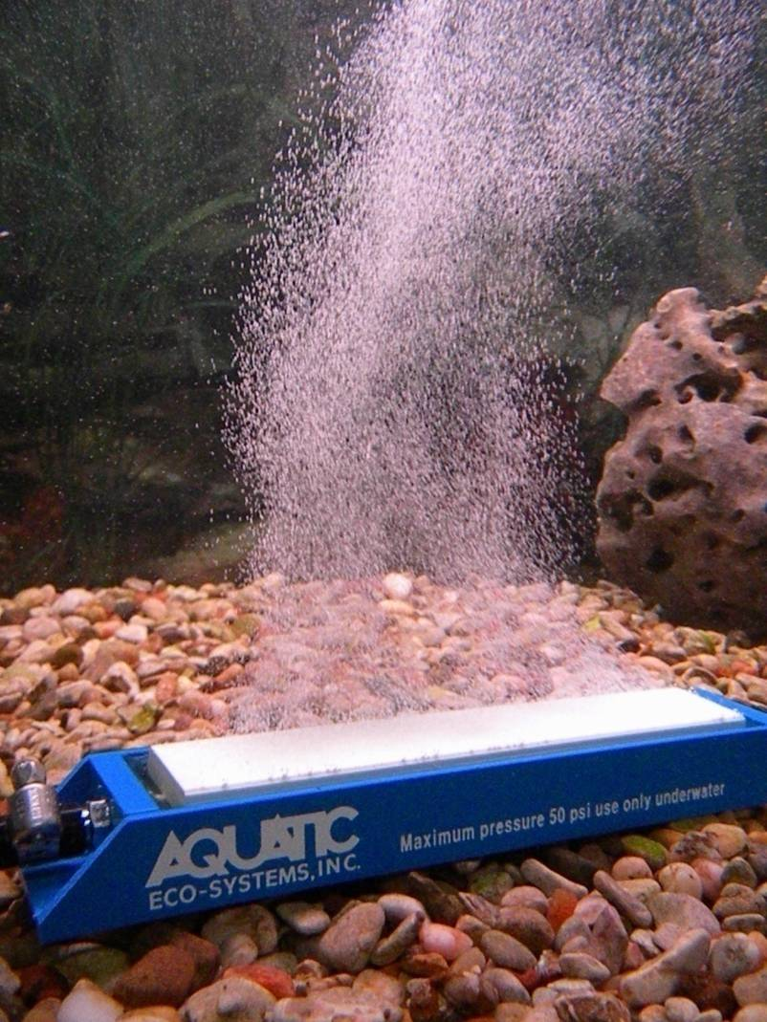
Livewell Oxygen Injection
Texas Parks and Wildlife Department
Inland Fisheries Division
(updated 03/13/2024)

Slide 2
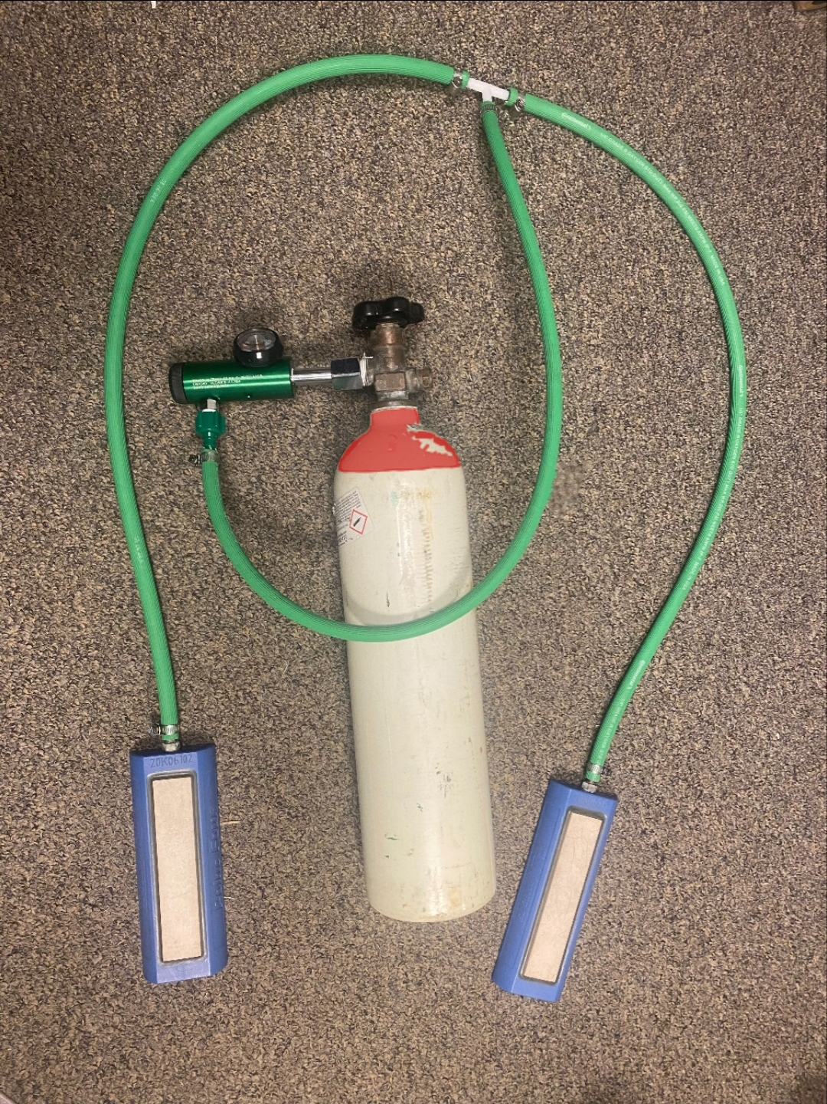
Overview
Dissolved oxygen is the most critical factor for maintaining health of black bass retained in livewells.
Various oxygen equipment was tested to determine a simple, effective, affordable, and safe system for maintaining sufficient dissolved oxygen in livewells (> 7.0 ppm).
This presentation recommends system components and describes installation, operation, and safety.
Complete oxygen injection system

Slide 3
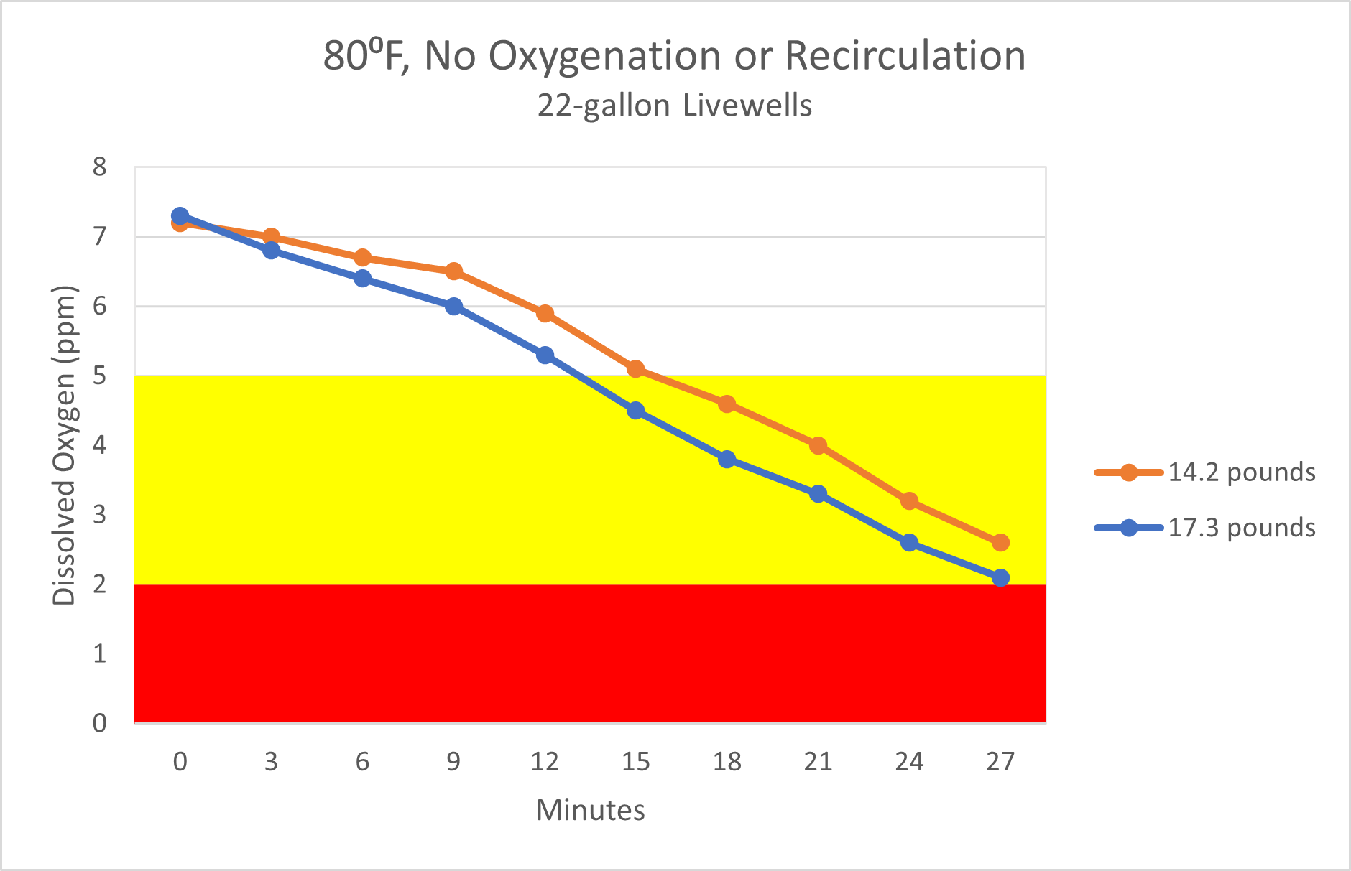
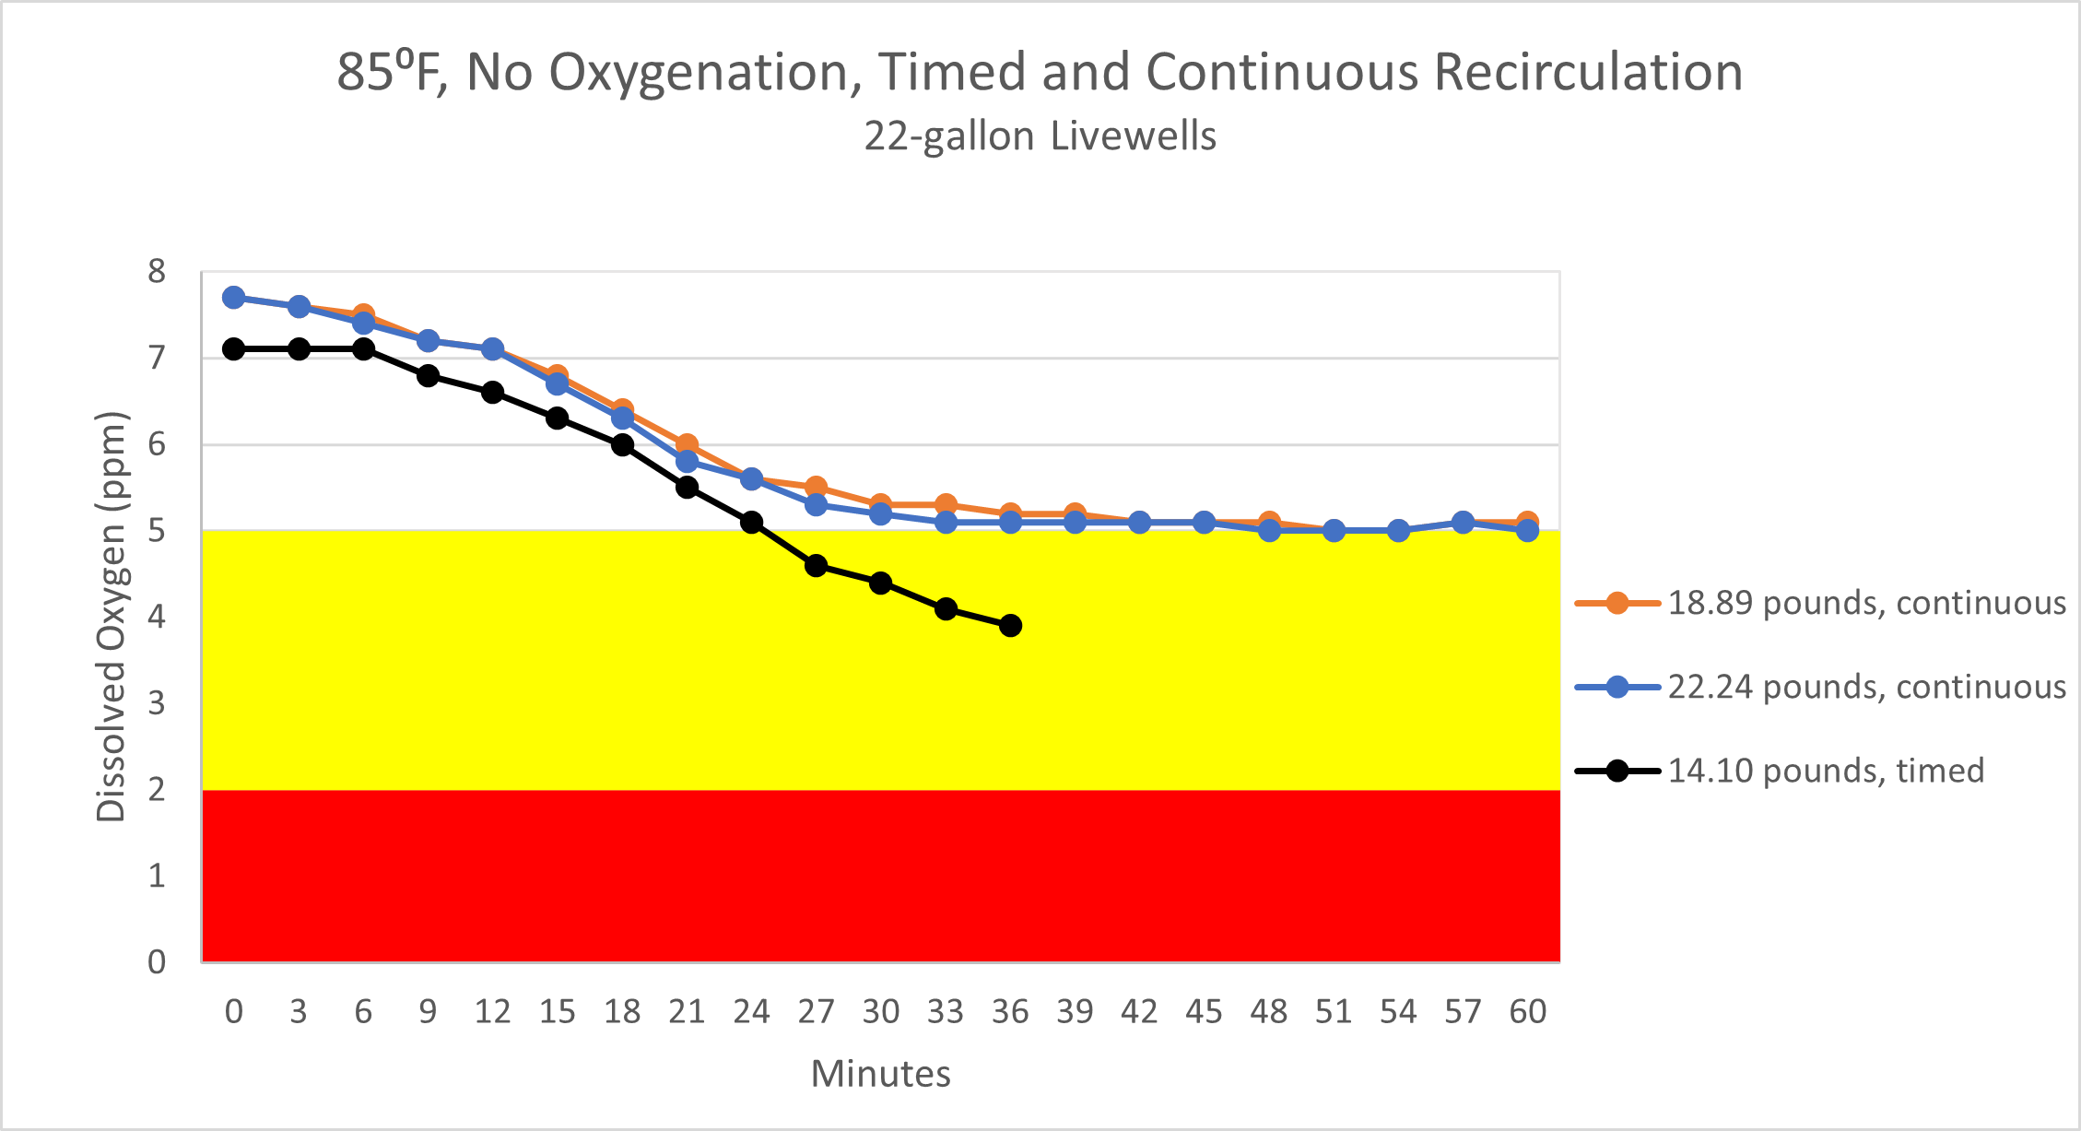
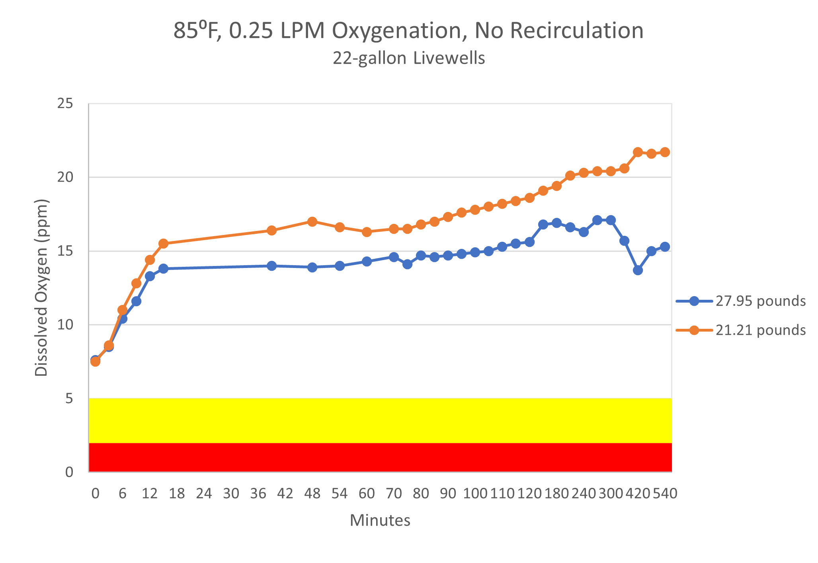
Oxygenation Charts
During warmer months, potential oxygen depletion in livewells is rapid with no recirculation or oxygenation.
With factory recirculation pumps, not possible to maintain sufficient oxygen levels with heavier weights at warmer water temperatures.
Oxygen Levels
Sufficient - > 7.0 ppm
Stressful - < 5.0 ppm
Lethal - < 2.0 ppm
At extreme conditions, oxygen injection (0.25 LPM of flow) maintained oxygen at 14 to 22 ppm over nine hours.

Slide 4
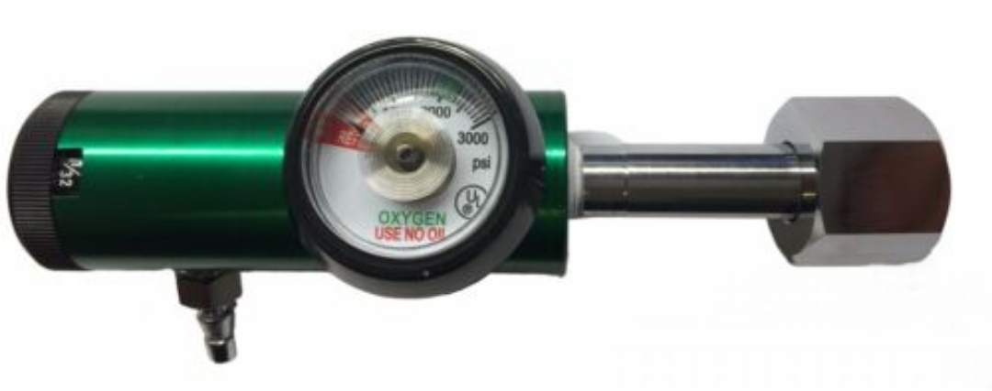
Industrial Oxygen Regulator
Industrial Oxygen Regulator
Industrial grade and not considered a medical device by FDA or Texas Department
of State Health Services.
CGA540 inlet and ¼” barb outlet.
PSI gauge which indicates fullness of oxygen bottle.
Adjustable flow, set to 0.25 LPM (1/4 LPM).

Slide 5
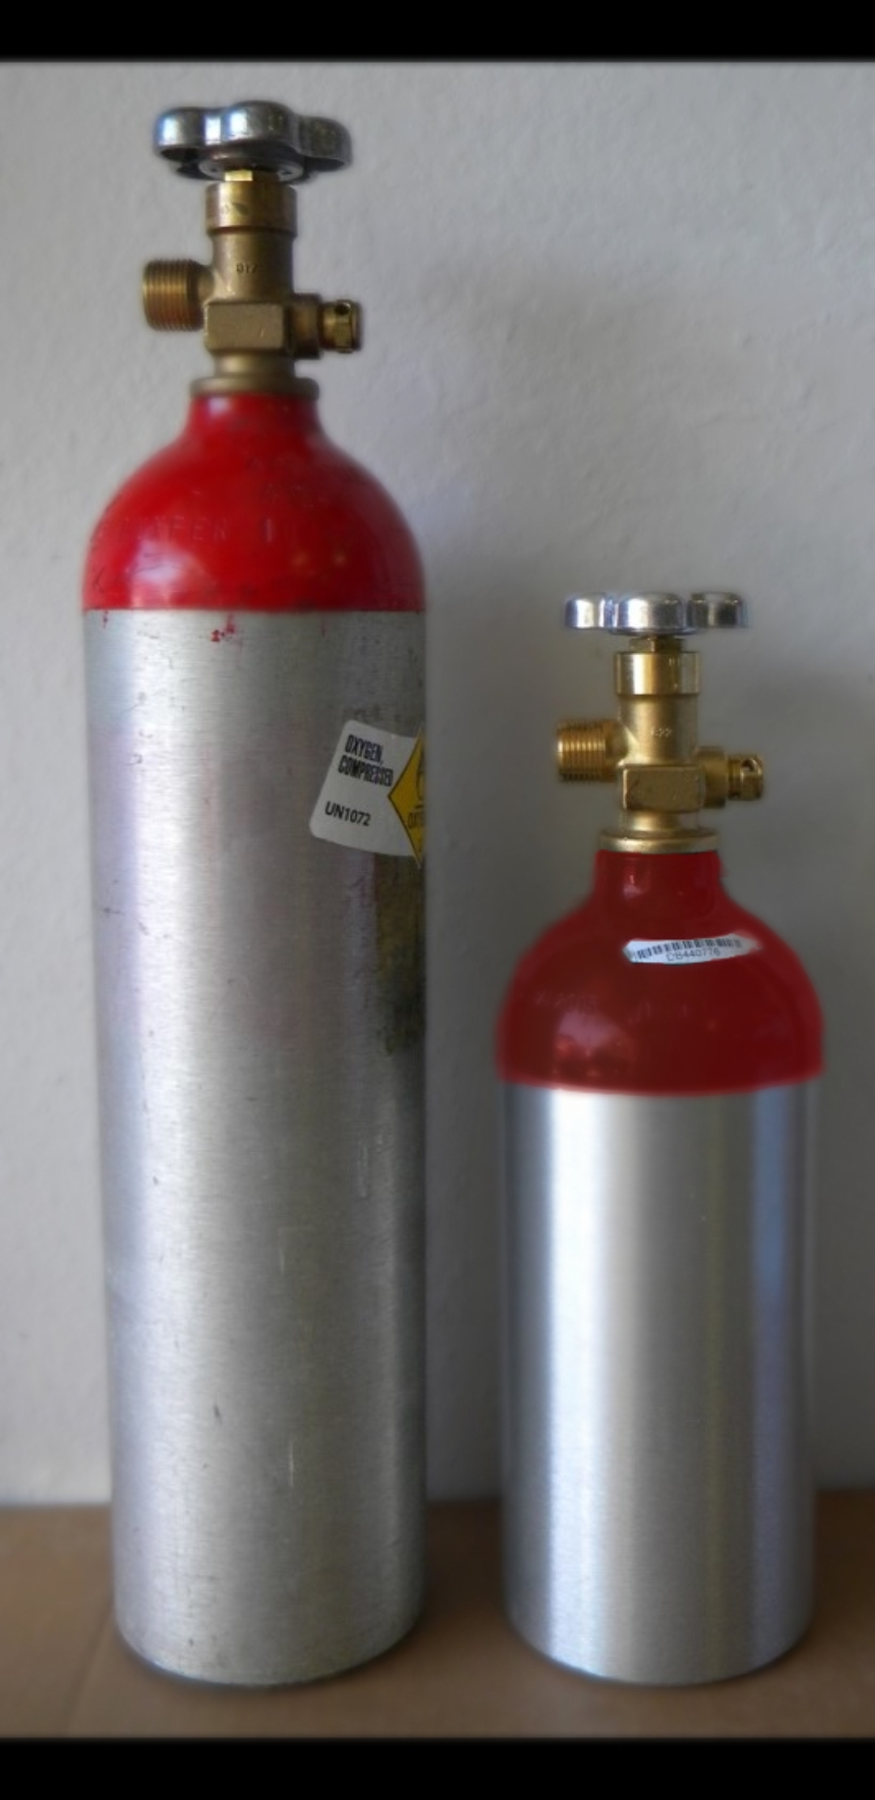
Oxygen bottle specs
Size classification | Capacity | Diameter (inches) | Length including valve (inches) | Total hours of use at 0.25 LPM and 4-inch diffusers
MD or D | 15 ft³ | 4.4 | 20 | 35
M9 or C | 9 ft³ | 4.4 | 14.2 | 20
Use of a CGA540 valve permits use and refill with welding (industrial) grade oxygen. Use of medical grade oxygen is by prescription only.
Bottle top will often be painted red by oxygen supplier to indicate its filled with welding grade oxygen.

Slide 6
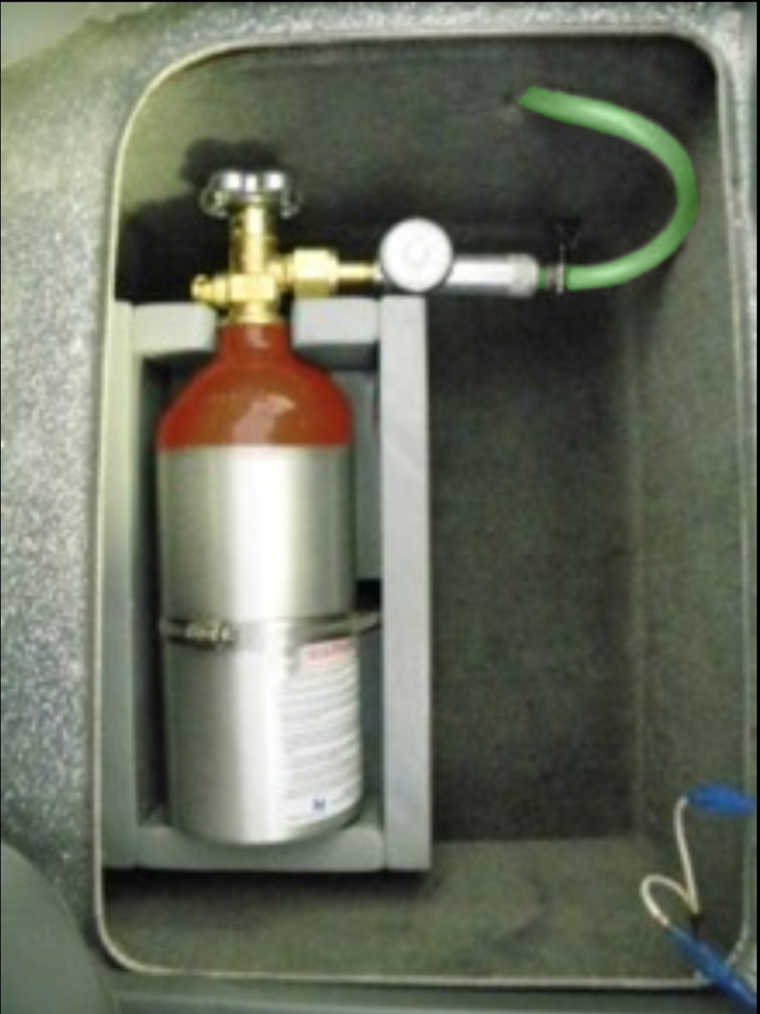
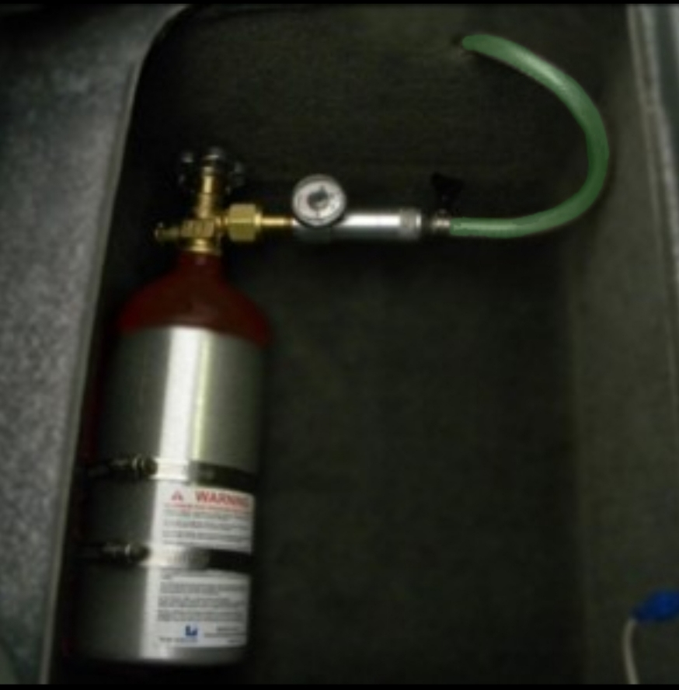
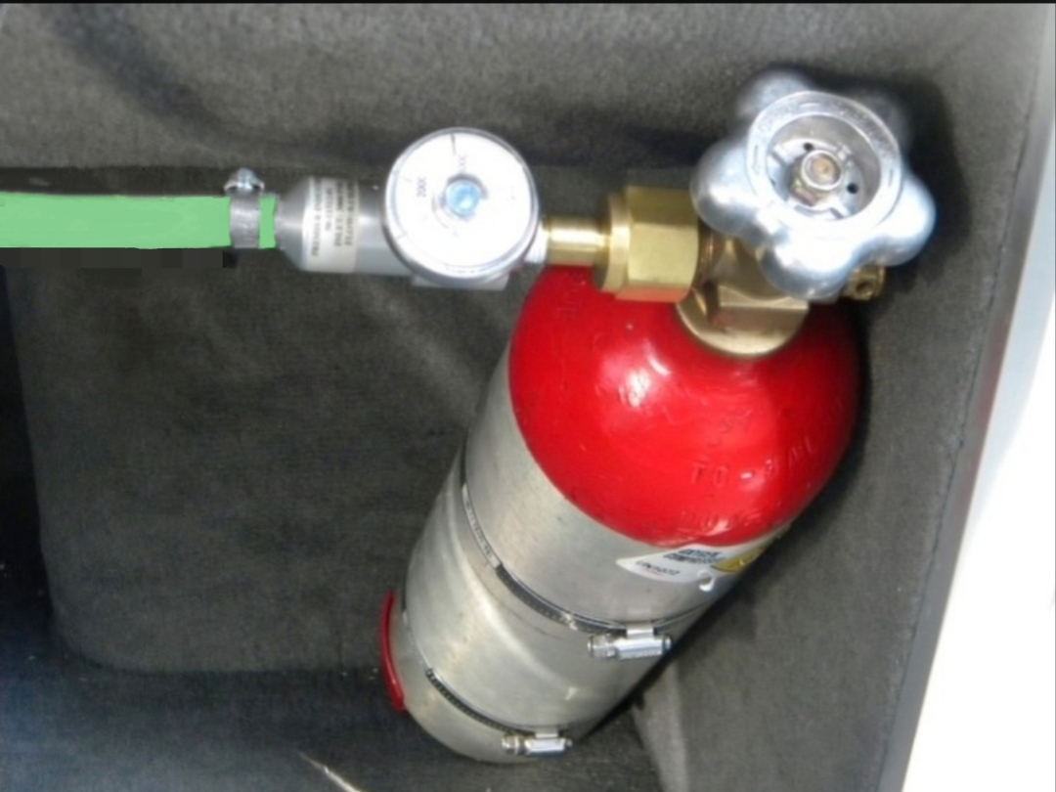
Oxygen Bottle Best Practices
Securely store or mount bottle protecting it and the regulator from impact and excessive vibration.
Consider different bottles sizes when choosing mounting location.
Do not locate bottle in boat bilge or in compartments containing oil, gas, or batteries.
Remove oxygen bottle from boat when not planning to use.
9 ft³ bottle mounted in wood box
in compartment under seat
5 lb. fire extinguisher bracket
and large hose clamps
9 ft³ bottle mounted with fire extinguisher
bracket in compartment under seat
15 ft³ bottle mounted with fire
extinguisher bracket under console

Slide 7
Safety
There are no federal or Texas regulations specific to use and storage of oxygen equipment on recreational fishing boats.
Aluminum bottles require re-testing every 5 years
Oxygen by itself is not flammable, however the pure form is a dangerous accelerant and highly reactive to oil-based products.
Do not smoke around oxygen equipment
Do not use products containing oil on or around oxygen equipment (e.g. WD-40, silicone, etc.) or combustion of these may occur
Test all connections with soapy water to ensure there are no oxygen leaks before use.
Cable/zip ties were inadequate
Use hose clamps or more secure connectors
Frequently re-check hoses and connections for leaks and damage
Do not fill oxygen bottle from another bottle (i.e. transfill). Bottle or valve failure could result.

Slide 8
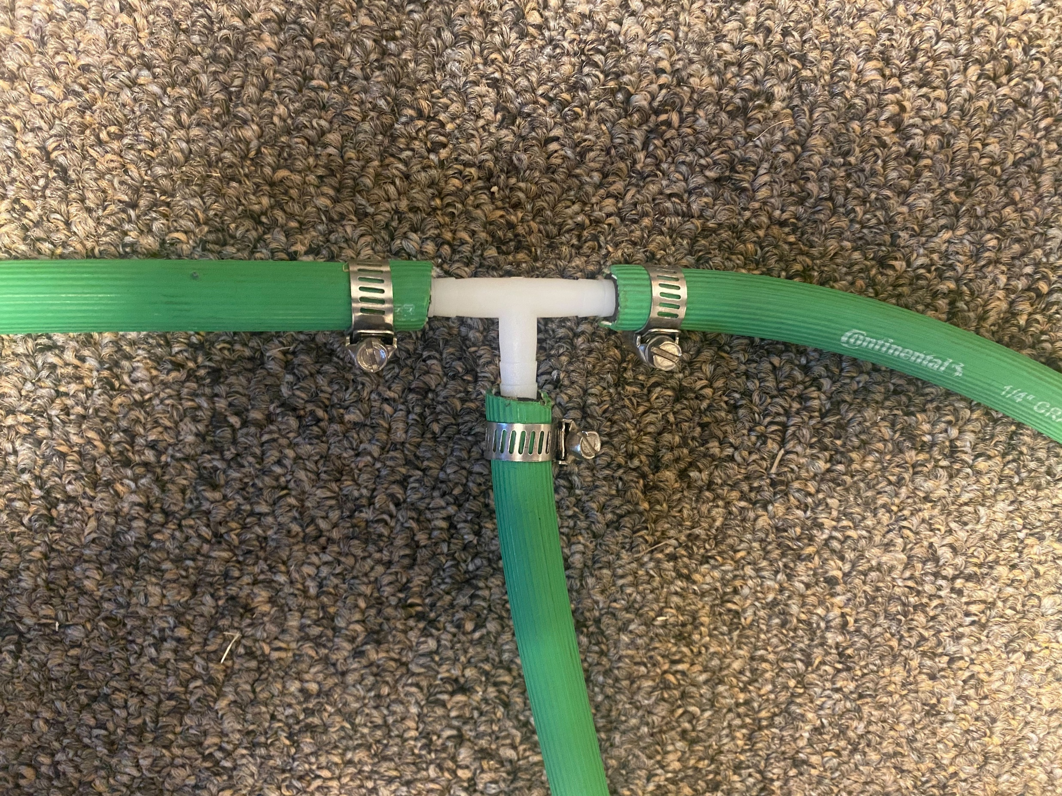
Oxygen Lines
Most bass boats have two independent livewells. The single
oxygen line from the regulator is split to form two lines to facilitate oxygen
injection into both livewells.
This “tee” connection should be made as
as near as possible to where oxygen line
will be routed thru the rear wall of
the livewells.
¼ “ ID oxygen-rated hose should
be used between the regulator and
livewell.
The hoses running from the tee to the
oxygen diffusers should be equal
length.
1/4“ barbed tee
livewell 2
livewell 1
regulator

Slide 9
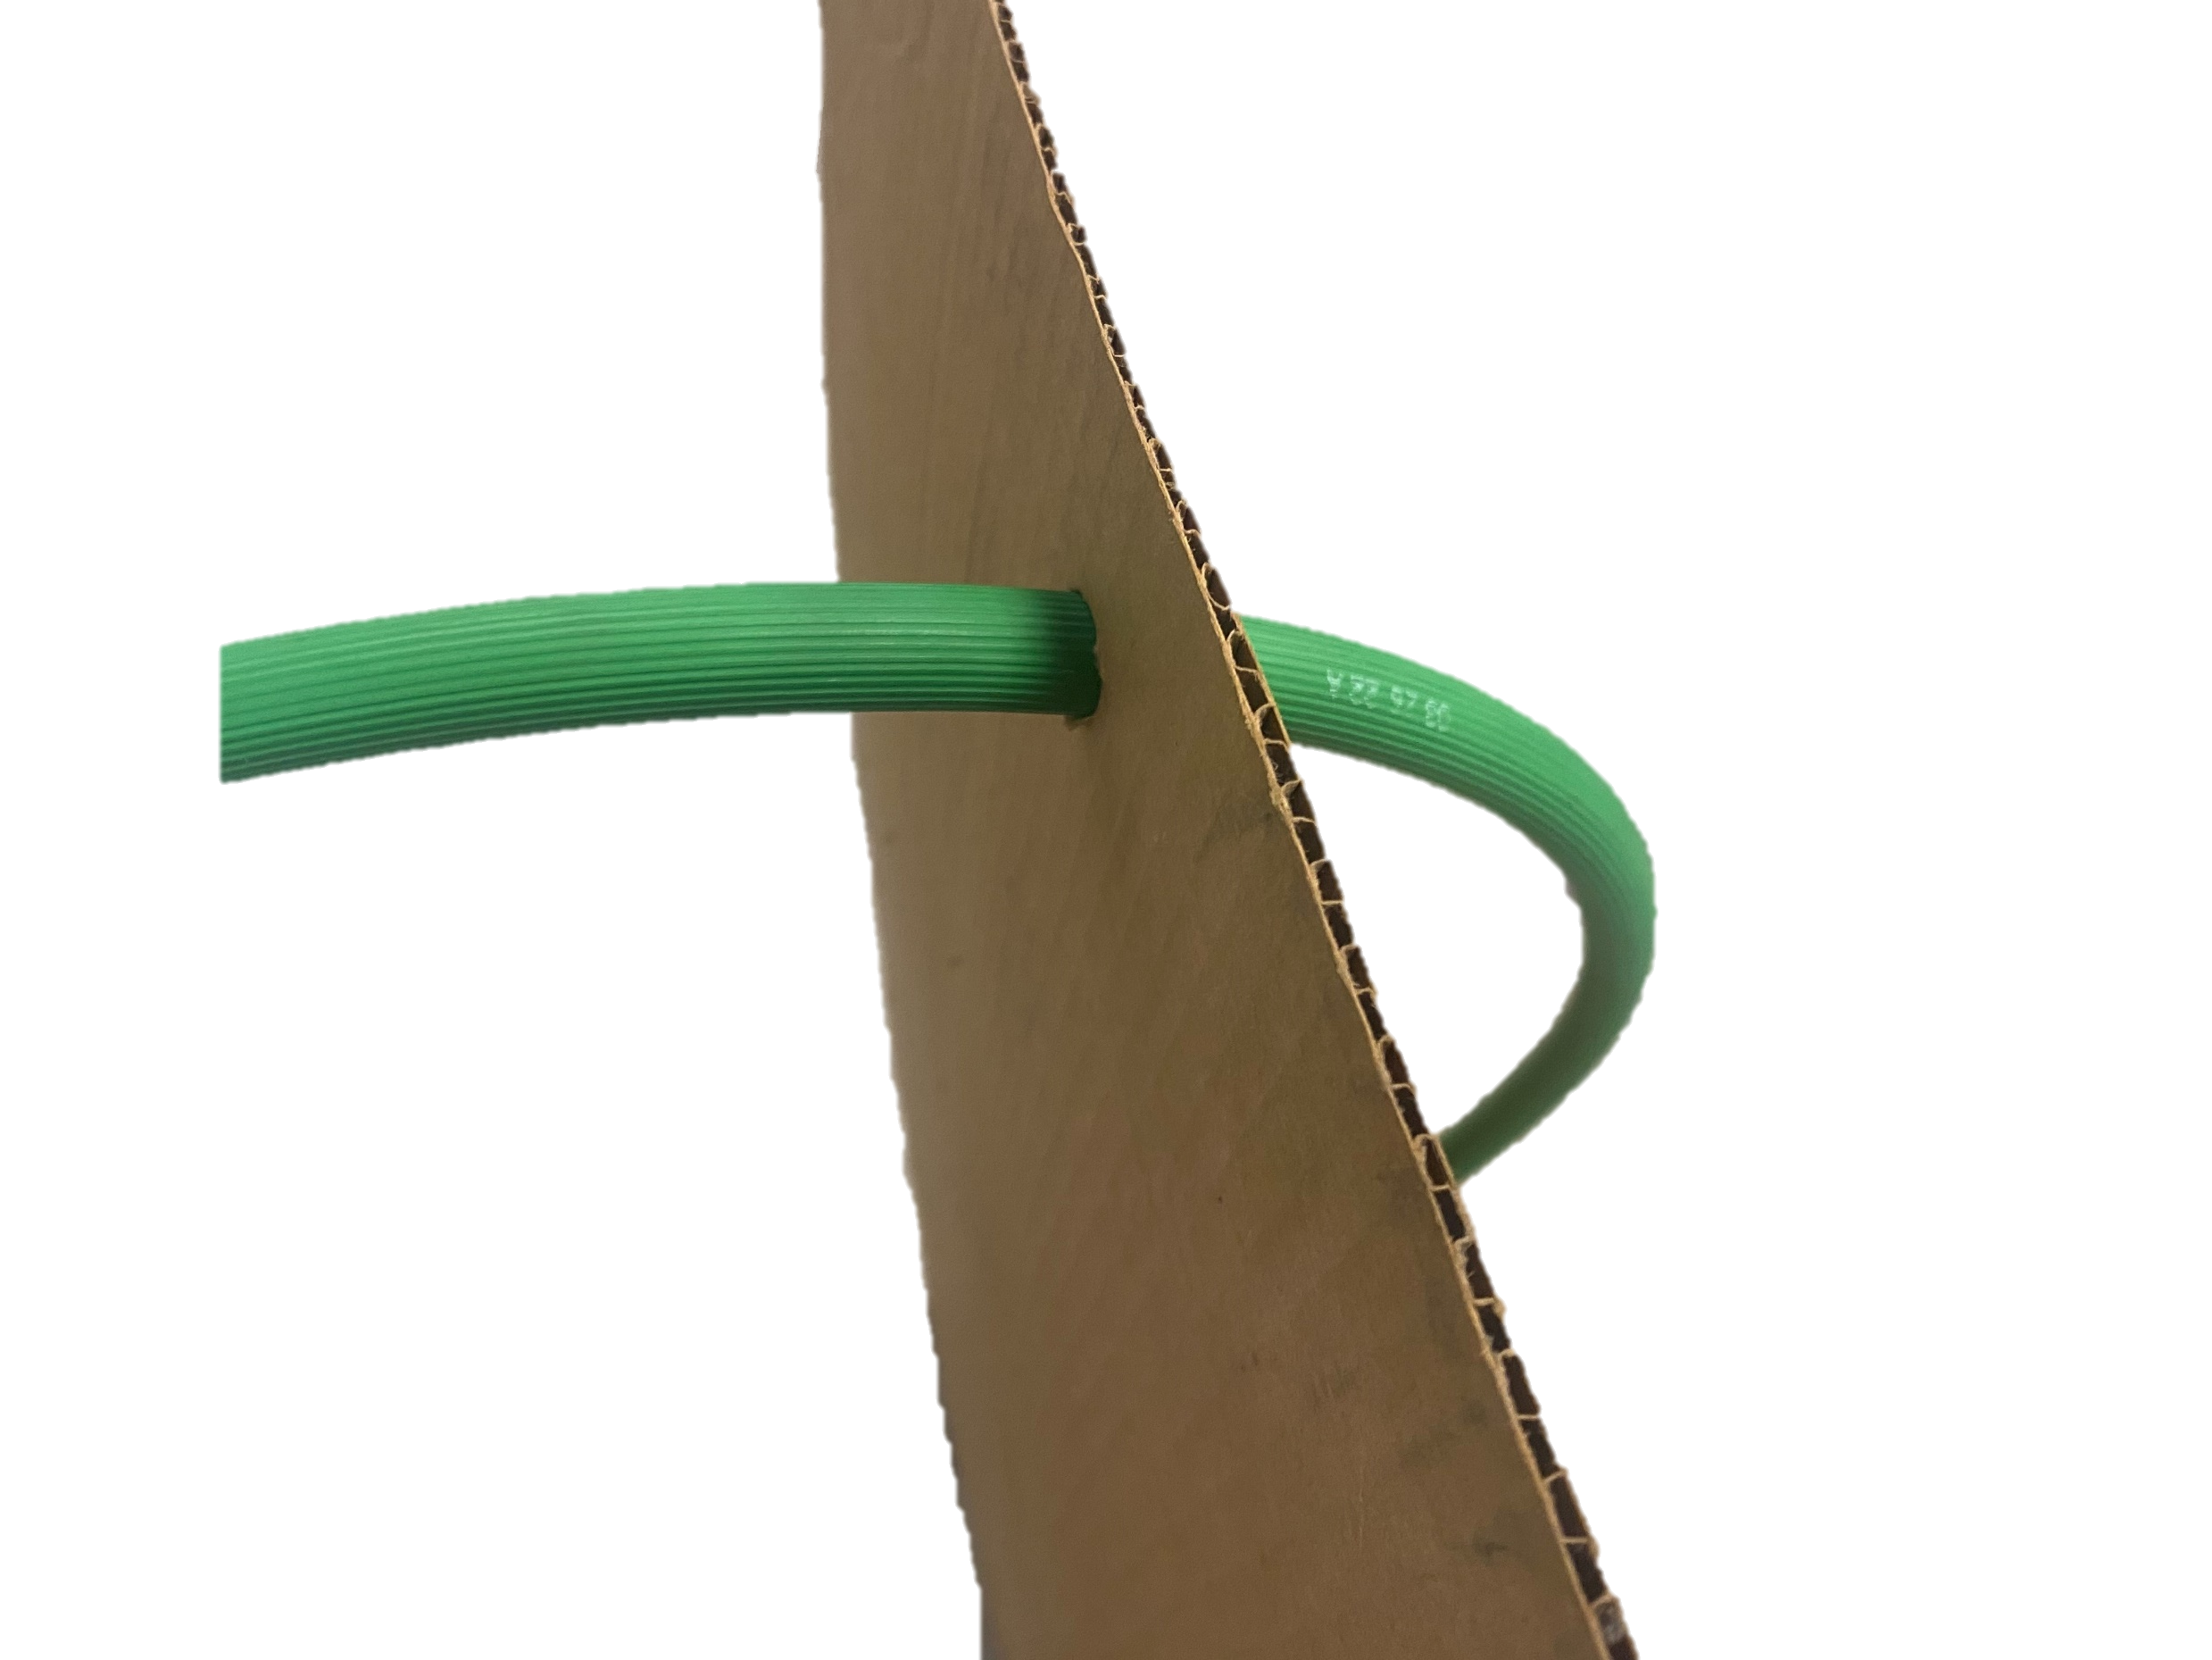
Hose Photo
Route hoses from “tee” fitting through upper rear livewell
wall to oxygen diffusers

Slide 10
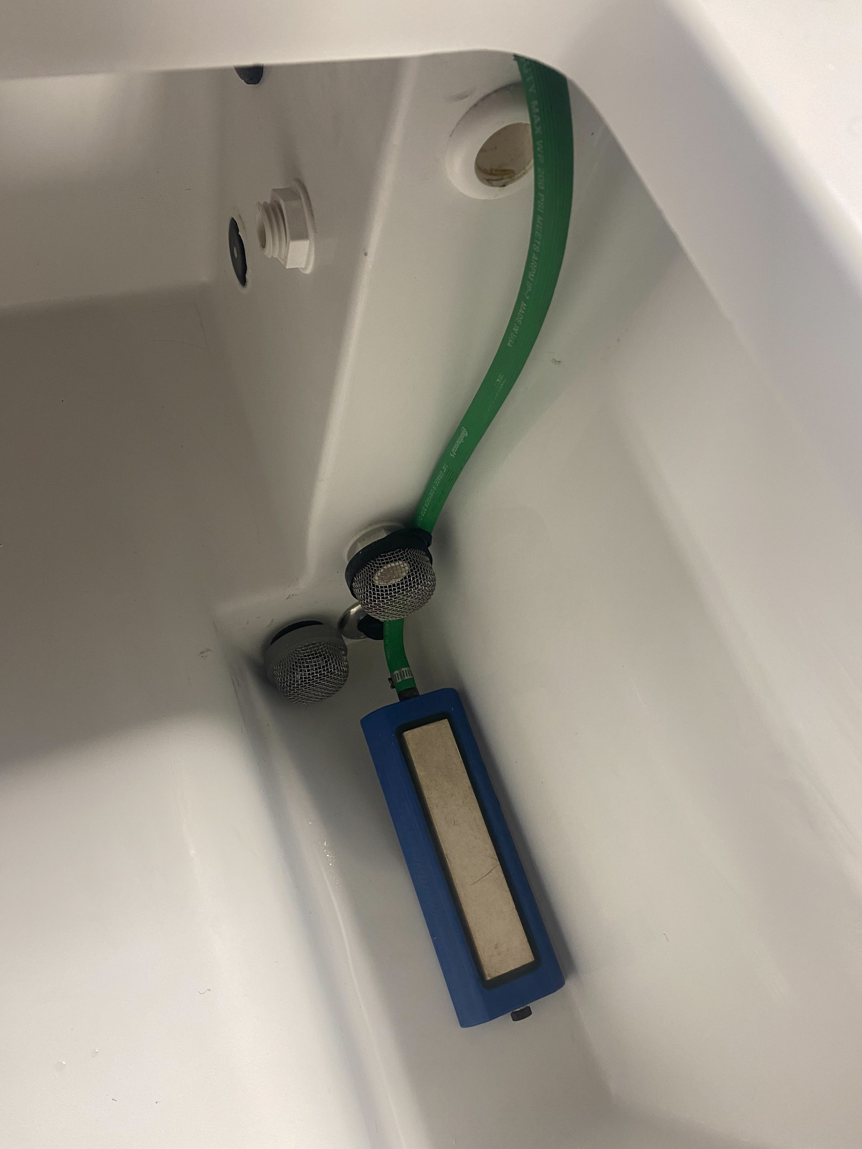
Operation
Oxygen injection and recirculation pumps
recommended when water temperatures exceed 75˚F.
Running recirculation pumps is required with oxygen injection to prevent carbon dioxide from reaching stressful levels. Running pumps diffuses most carbon dioxide out of the livewell water.
Turn the knob counterclockwise on the CGA540
valve to inject oxygen.
Set flow knob on regulator to 0.25 LPM (1/4).
Diffusers will take 3-4 minutes to pressurize before
producing oxygen bubbles.
Both livewells must be filled with water for
diffusers to function properly. If one livewell is
filled and the other left empty, all oxygen will flow
out the diffuser in the livewell having no water
due to path of least resistance.
The surface of the diffusers can be cleaned using
60-grit sandpaper if dirt or build-up hamper performance.
Operation

Slide 11
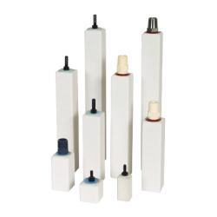
Operation continued
Safety should be the primary concern if modifying system or
substituting components.
Lower quality diffusers are much less efficient and will not achieve desired oxygen level at the recommended oxygen injection rate of 0.25 LPM.

Slide 12
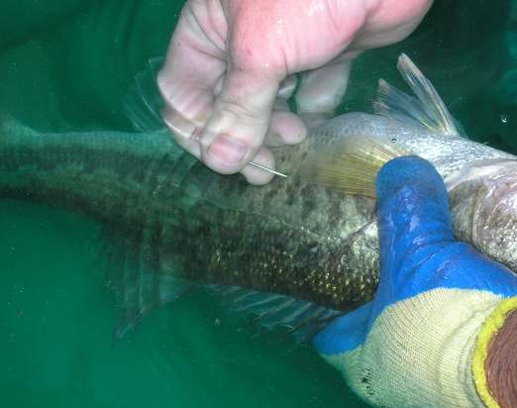
Overall Livewell Management
Overall Livewell Management
More information on livewell oxygen injection
https://tpwd.texas.gov/fishboat/fish/recreational/catchrelease/livewell.phtml
Other proven livewell management techniques
B.A.S.S. publication Keeping Bass Alive
Cooling the water
Addition of stock salt (unionized)
https://www.bassmaster.com/wp-content/uploads/2022/04/keepingbassalive_guidebook_comp.pdf
Fizzing
http://www.tpwd.state.tx.us/newsmedia/releases/?req=20110202d

Slide 13
Component, Cost, and Supplier List
Component, Cost, and Supplier List
Item | Part Number | Cost | Supplier
Aluminum Oxygen Bottle
15 ft3 capacity (MD) with standard CGA540 valve | 15CUFTALVLV-5LBEQ-540 | $85 | Gas Cylinder Source gascylindersource.com 866-395-5049
 |  |  | or local gas company
Industrial Oxygen Regulator
CGA540 inlet, 1/4" barb outlet, capable of 0.25 LPM flow | 540 Industrial Regulator, 0-4 LPM | $77 | Simply O3 Simplyo3.com 844-655-2524
Oxygen Fill
Welding grade oxygen |  | $15 | Local Gas Supplier
Bottle Mounting Bracket |  |  | Hallmann Sales
Larsen’s 5-lb fire extinguisher bracket | 821 | $29 | hallmann-sales.com
 |  |  | (866) 966-9596
Diffusers, Fittings, Tubing, and Clamps
2 - Sweetwater Micro Bubble Oxygen Diffusers 4” x 2.5” diffusing area | DYPFP4 | $92/pair | Pentair Aquatic Eco-systems
 |  |  | pentairaes.com
 |  |  | 877-347-4788
¼” ID green oxygen hose | OX4F | $2/ft.
¼” tee (barb) connector | 62064 | $1
2 - 4” hose clamps for fire ext. bracket | SSI | $6
6 - ¼” stainless steel hose clamps | SSAA | $8
Costs do not include shipping or tax and prices are subject to change. Equivalent items are available from other vendors.

Slide 14
Thank you
We thank the following for their assistance and comments:
Aquatic Ecosystems
AirGas
Matheson Tri-Gas
Coastal Gas
James and Tom Bendele (Falcon Lake Tackle)
Ken Parker (Boerne Marine)
Rick Pierce (Bass Cat Boats)
Gary Clouse (Phoenix Boats)
Gene Gilliland (Oklahoma Department of Wildlife Conservation)
Hal Schramm (Mississippi State University)
Carl Wengenroth (Angler’s Lodge)
TPWD-Inland Fisheries
Randy Myers
Jason Driscoll
Todd Driscoll
Todd.Driscoll@tpwd.Texas.gov
409-698-9114

